Slide 1
Exploratory Data Analysis for Real Estate Pricing
By: Garima Mahajan
Institute: Digicrome

Slide 2
Project Overview
Data cleaning and preprocessing was performed on Dataset.
The different methods employed for data wrangling were:
- Filling the null values in column
- Dropping out unnecessary columns
- Checked the datatypes, summary and dimensions of the dataset, treated the missing values
Identified the outliers and checked the skewness, correlation of the data.
Box-plots were constructed for visualising the data after treating the outliers
Heatmap was constructed to visualize the correlation of the data
Different EDA plots were plotted to check the important features using Groupby function
New features were developed using Feature Engineering

Slide 3
Methodology
Libraries used:
Pandas: Data manipulation library that provides data structures like DataFrames for easy handling and analysis of structured data.
NumPy: Fundamental library for numerical computing in Python, offering powerful array objects and mathematical functions for array operations.
Matplotlib: Comprehensive plotting library for creating static, interactive, and publication-quality visualizations in Python.
Seaborn: Statistical data visualization library that works well with Pandas and Matplotlib, offering high-level functions for creating informative statistical plots.
SimpleImputer: Was used to fill in (impute) missing values in your dataset
StandardScaler: Was used to standardizes features by removing the mean and scaling to unit variance
The code was executed in Google Colab notebook.

Slide 4
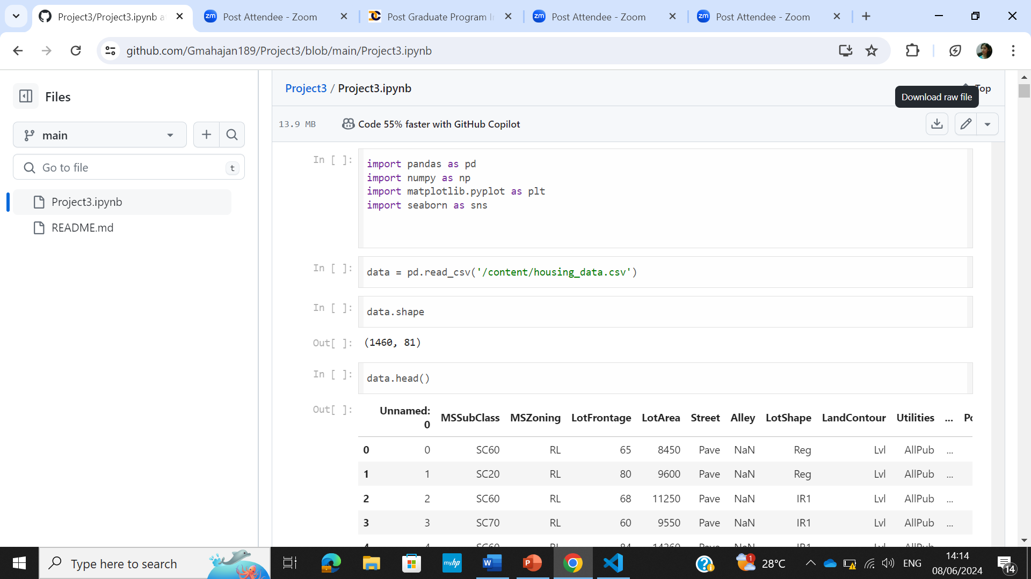
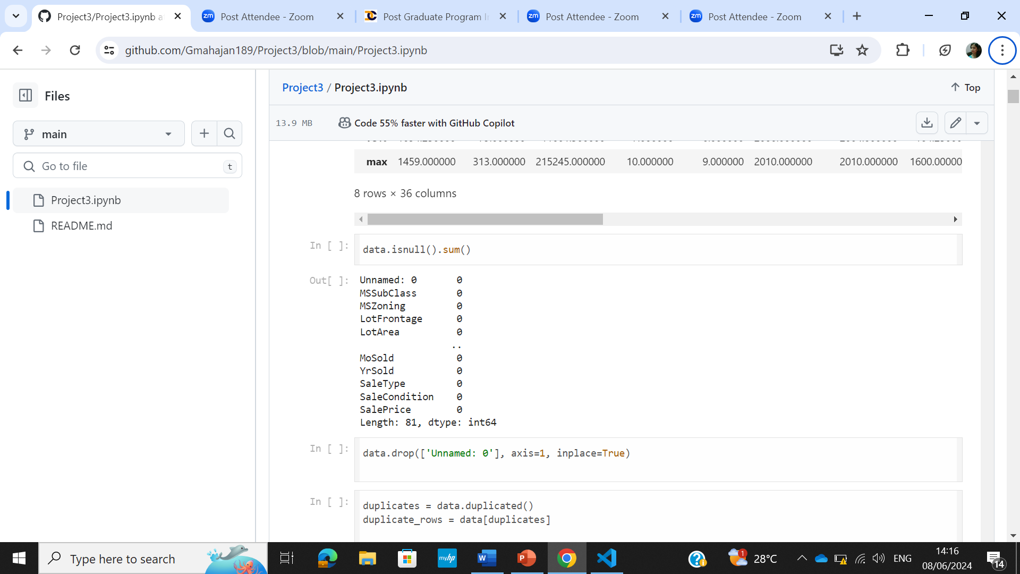
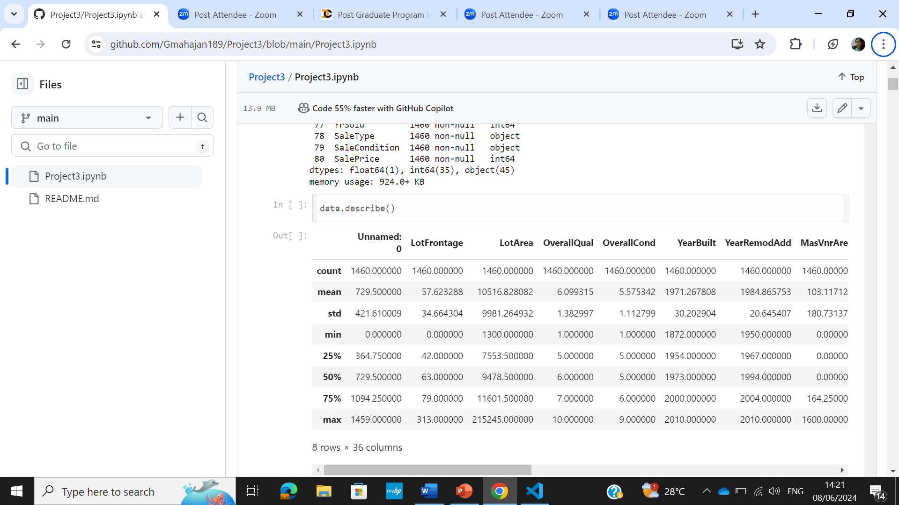
Solution
Importing the libraries
To read the csv file
To check dimension of the dataset
To check for the null values in the columns
To check the duplicate values
To get summary of the dataset

Slide 5
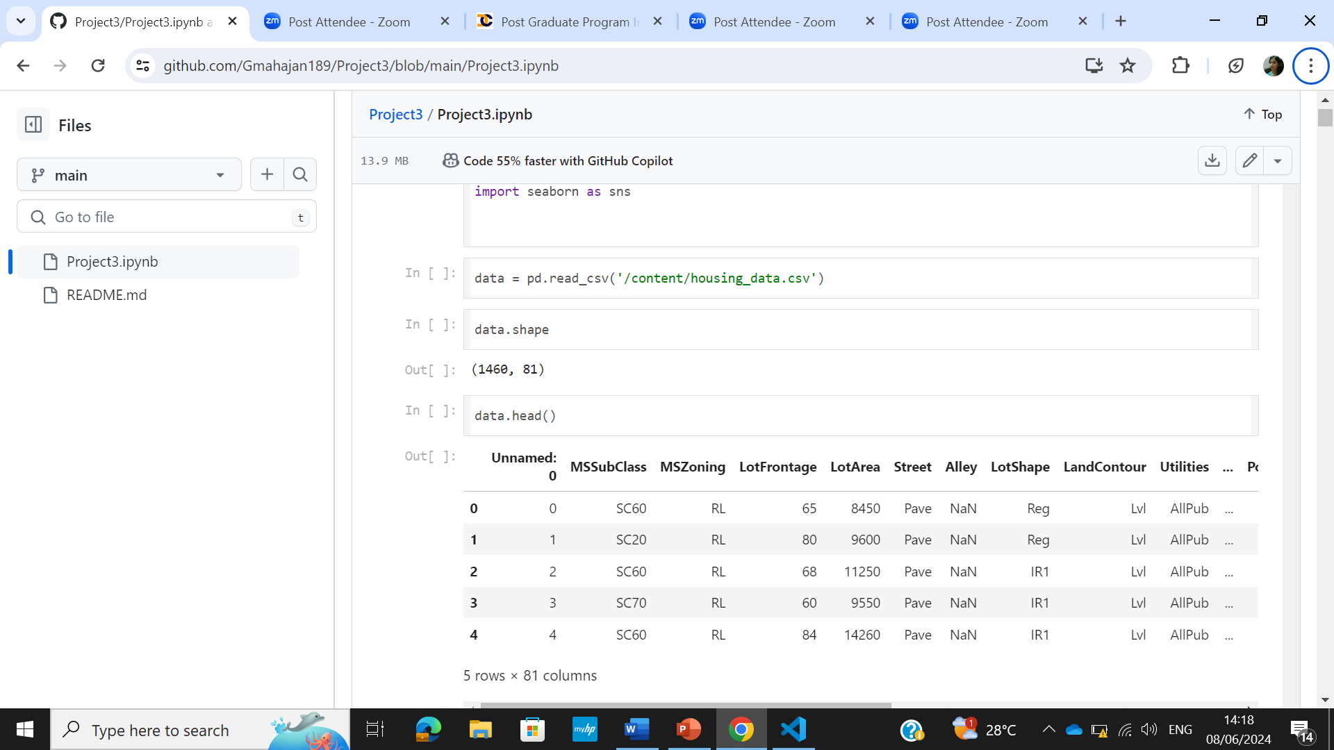
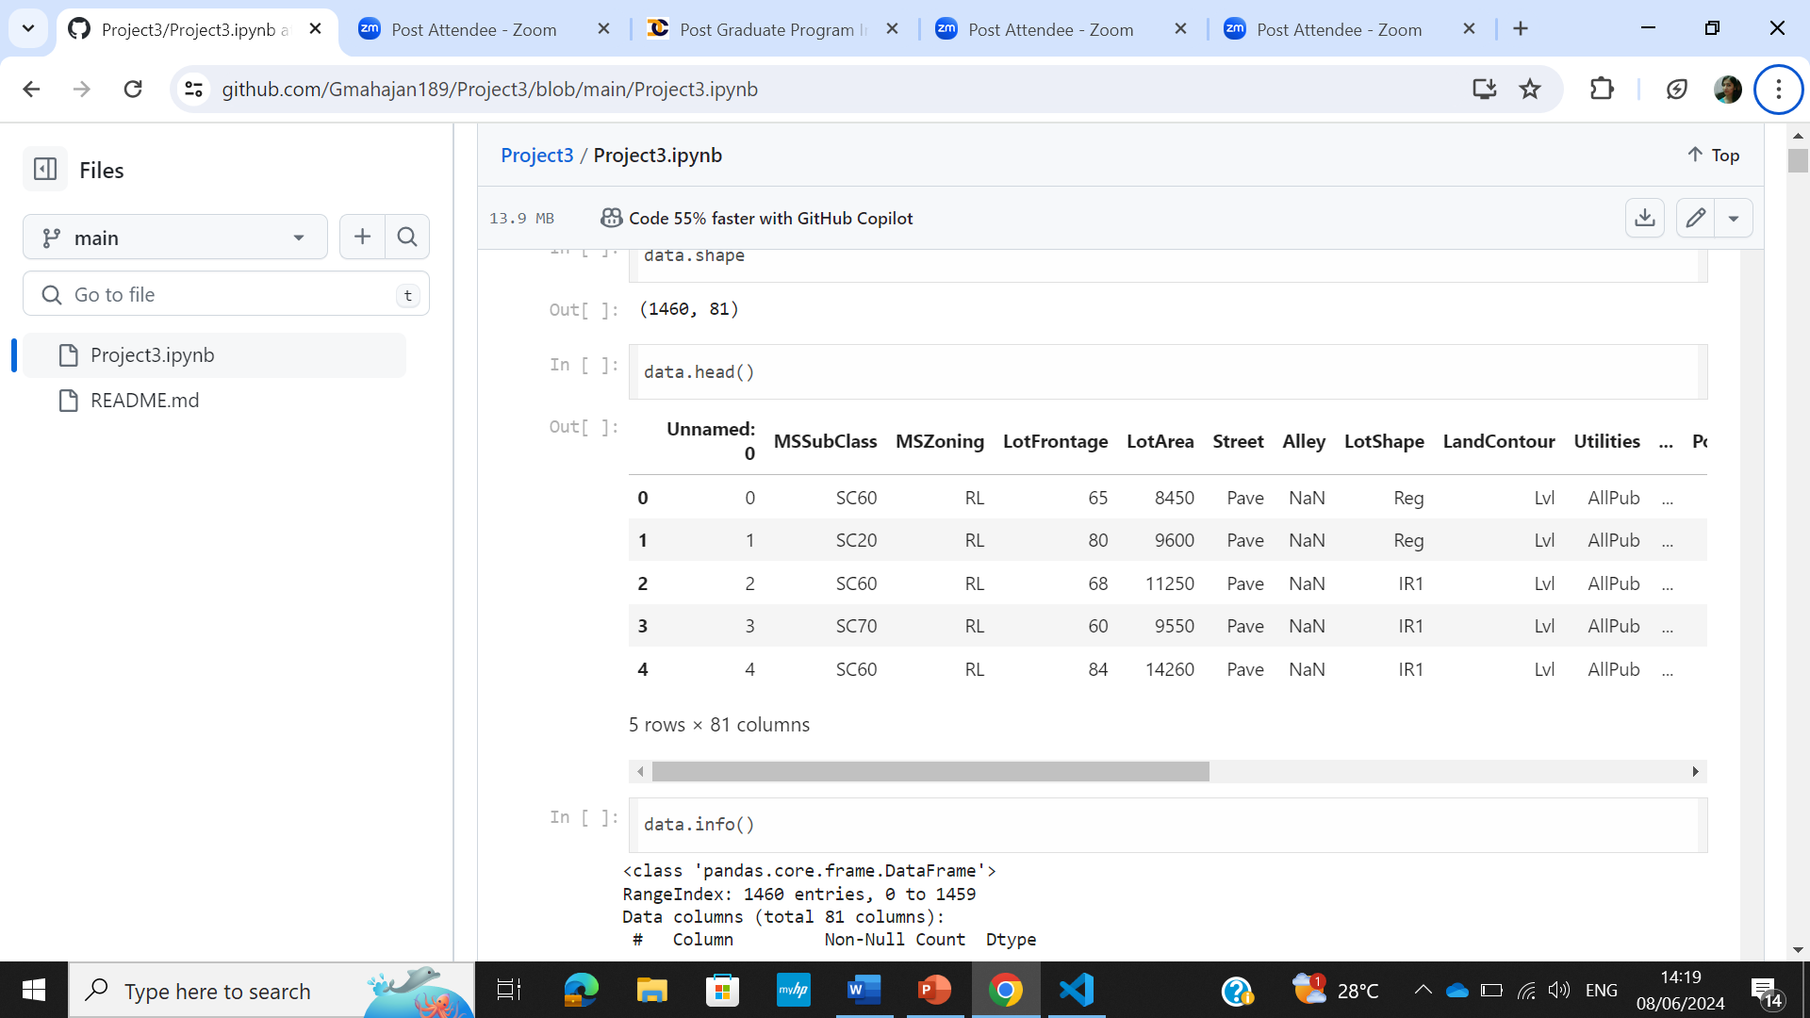
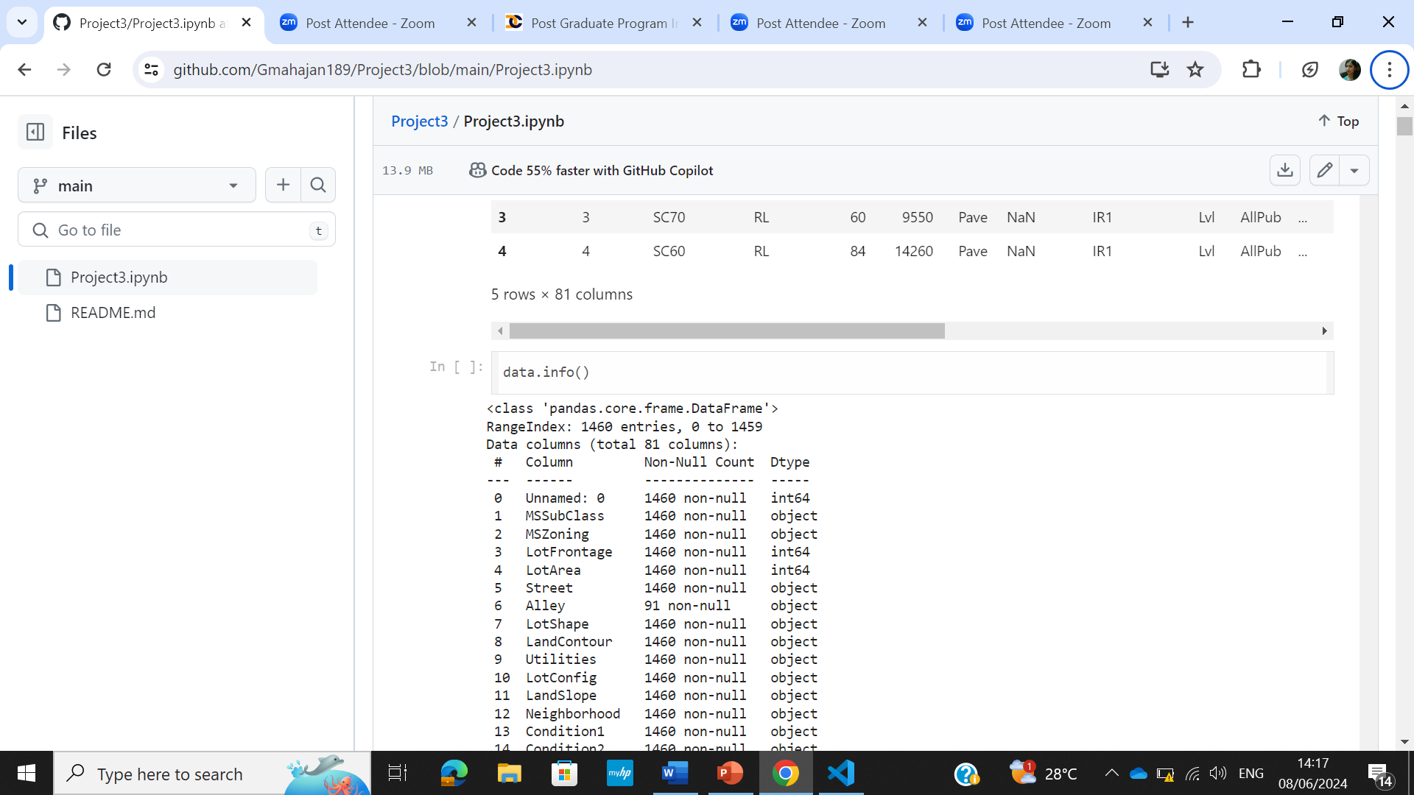
Solution
To read the excel file into pandas dataframe
To see the top 5 entries in the dataset
For the dataset information

Slide 6
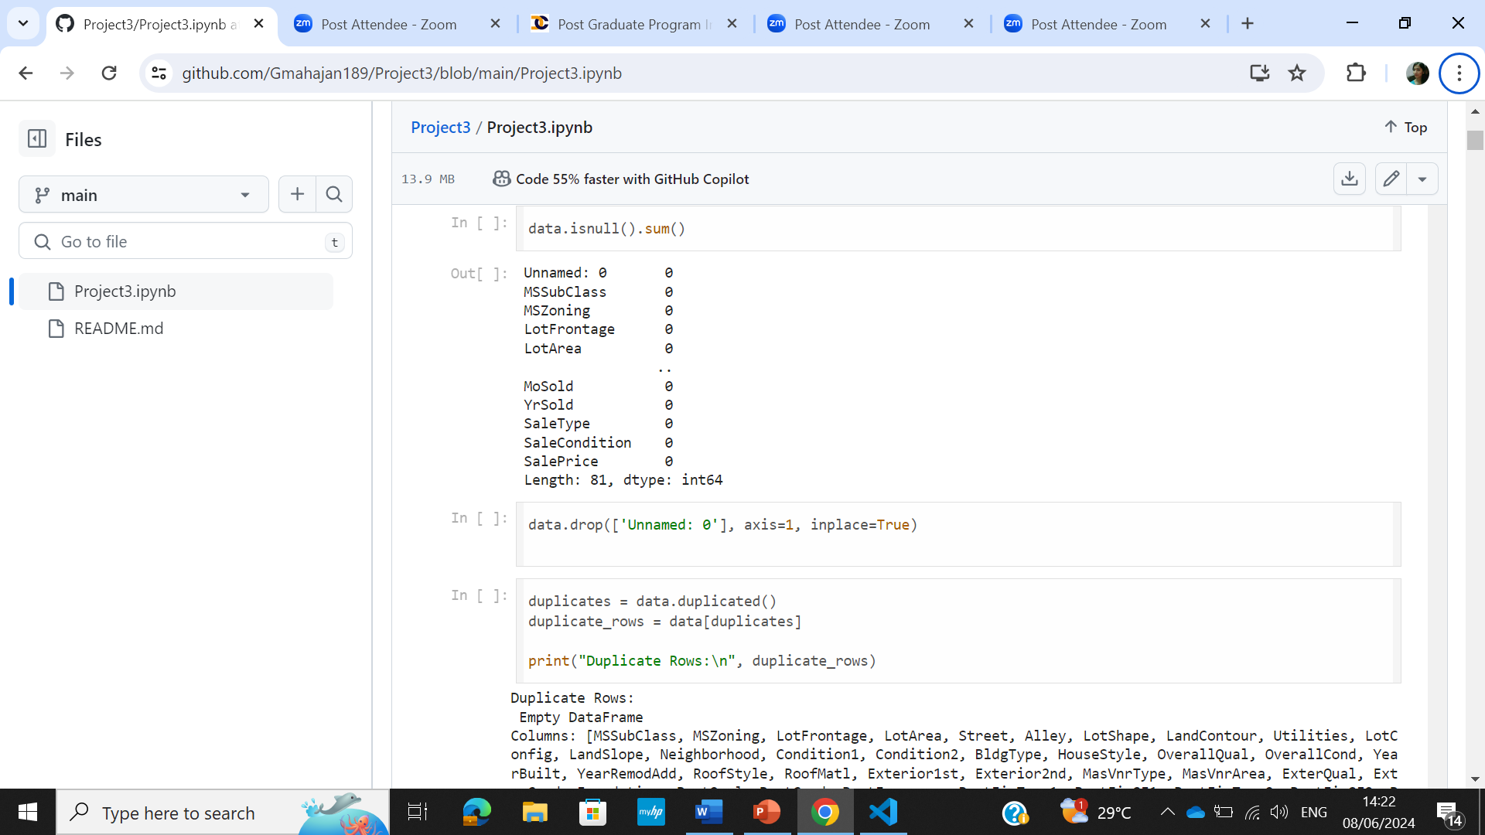
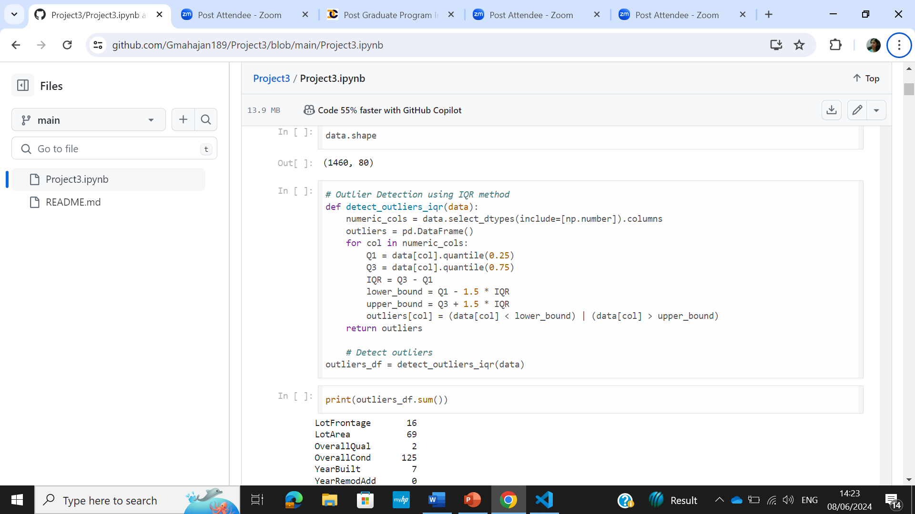
Solution
To drop the column
To check for the outlier columns and the number of outliers in each column

Slide 7
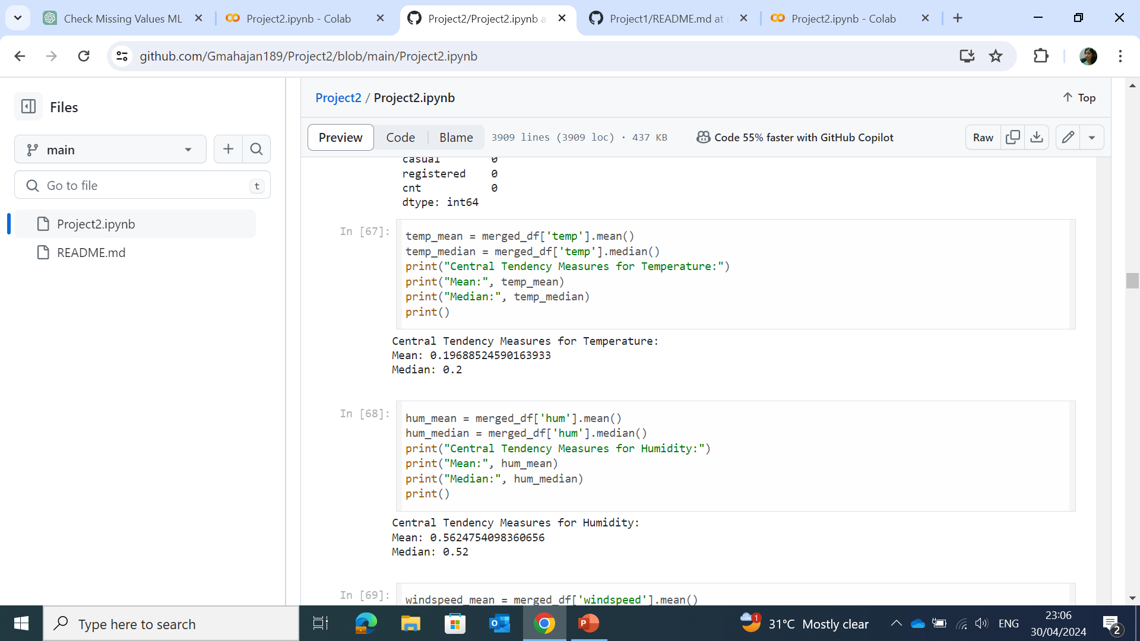
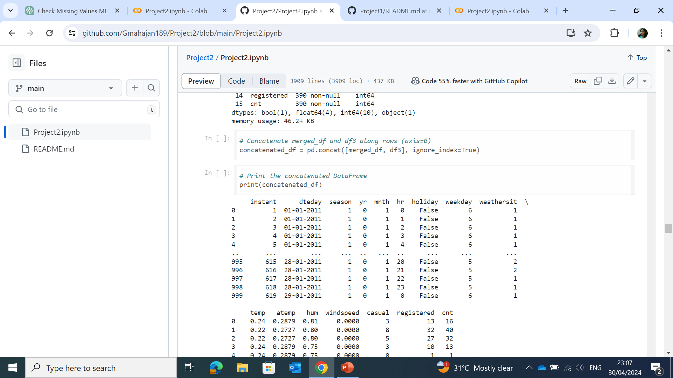
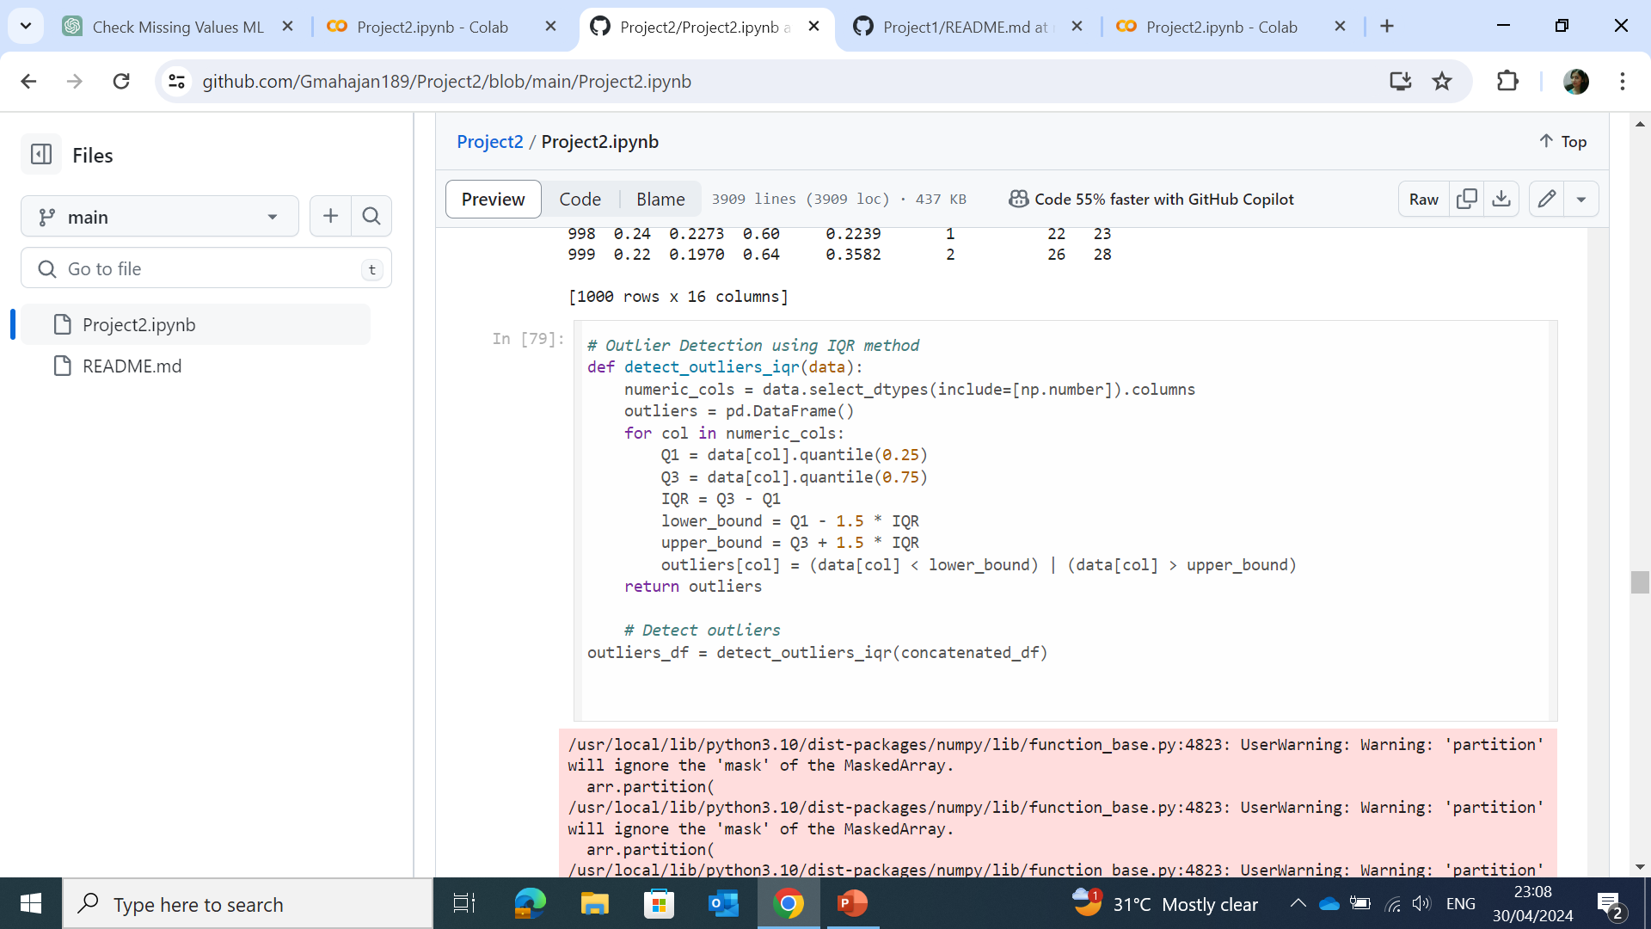
Solution
To check the central tendency of the data
Merge dataset 3 with the dataset1,2
Detect the outliers using InterQuartile Range

Slide 8
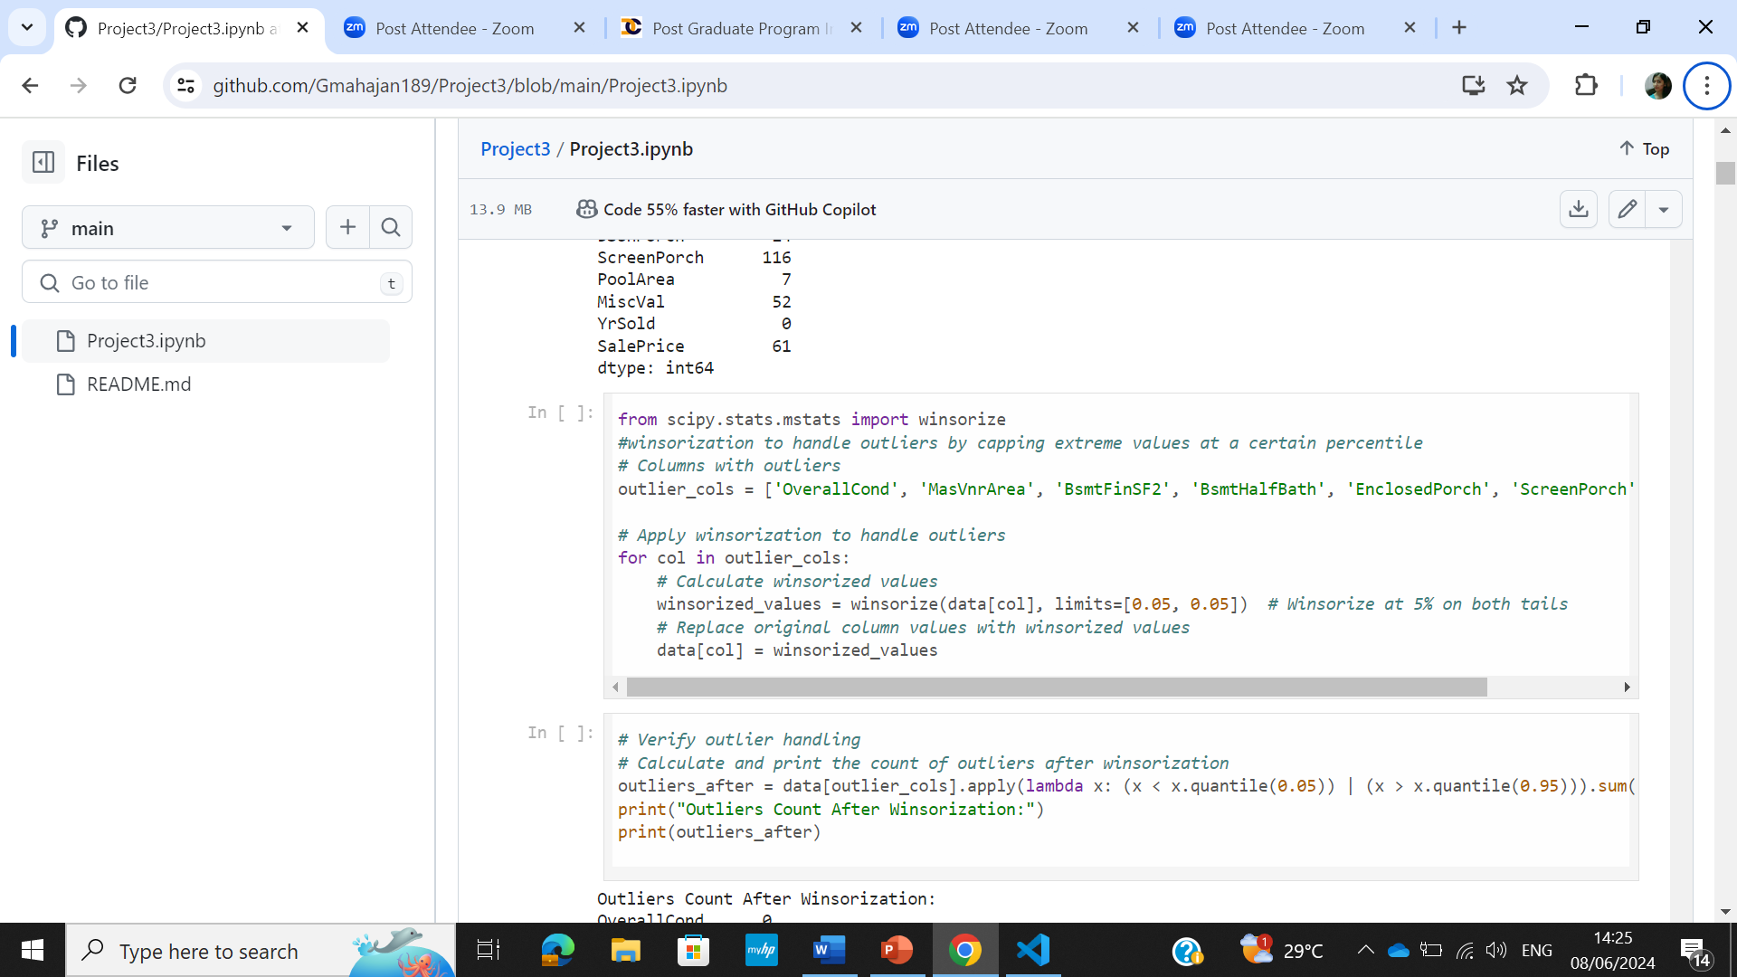
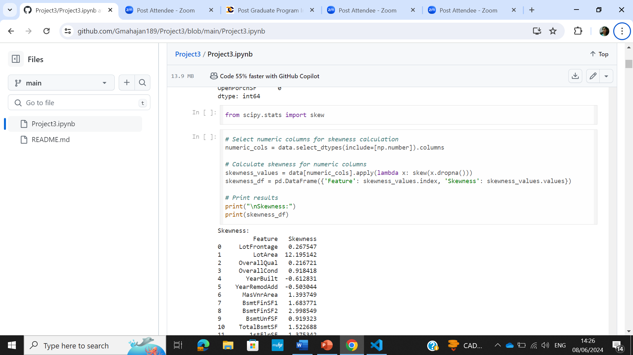
Solution
Winsorization was used to handle outliers
Skewness of the data was checked

Slide 9
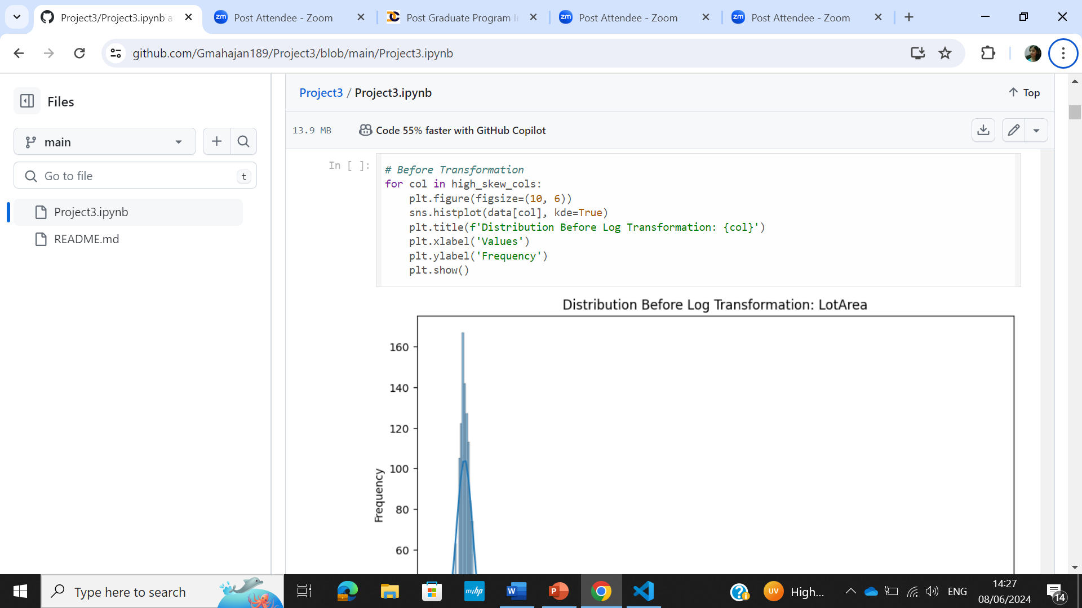
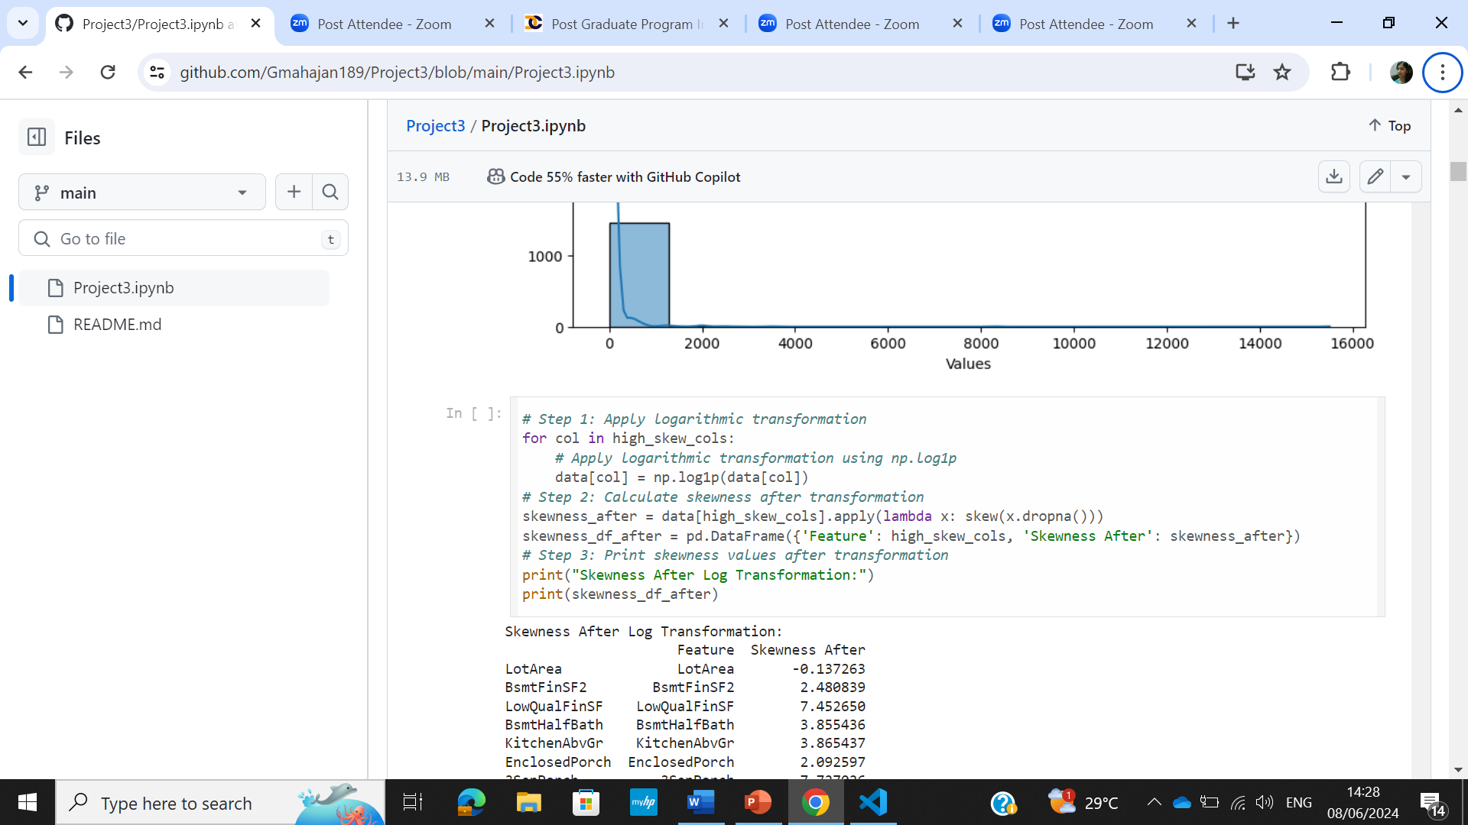
Solution
To check the distribution before transformation using histogram
The high skew columns were normalized using logarithmic transformation

Slide 10
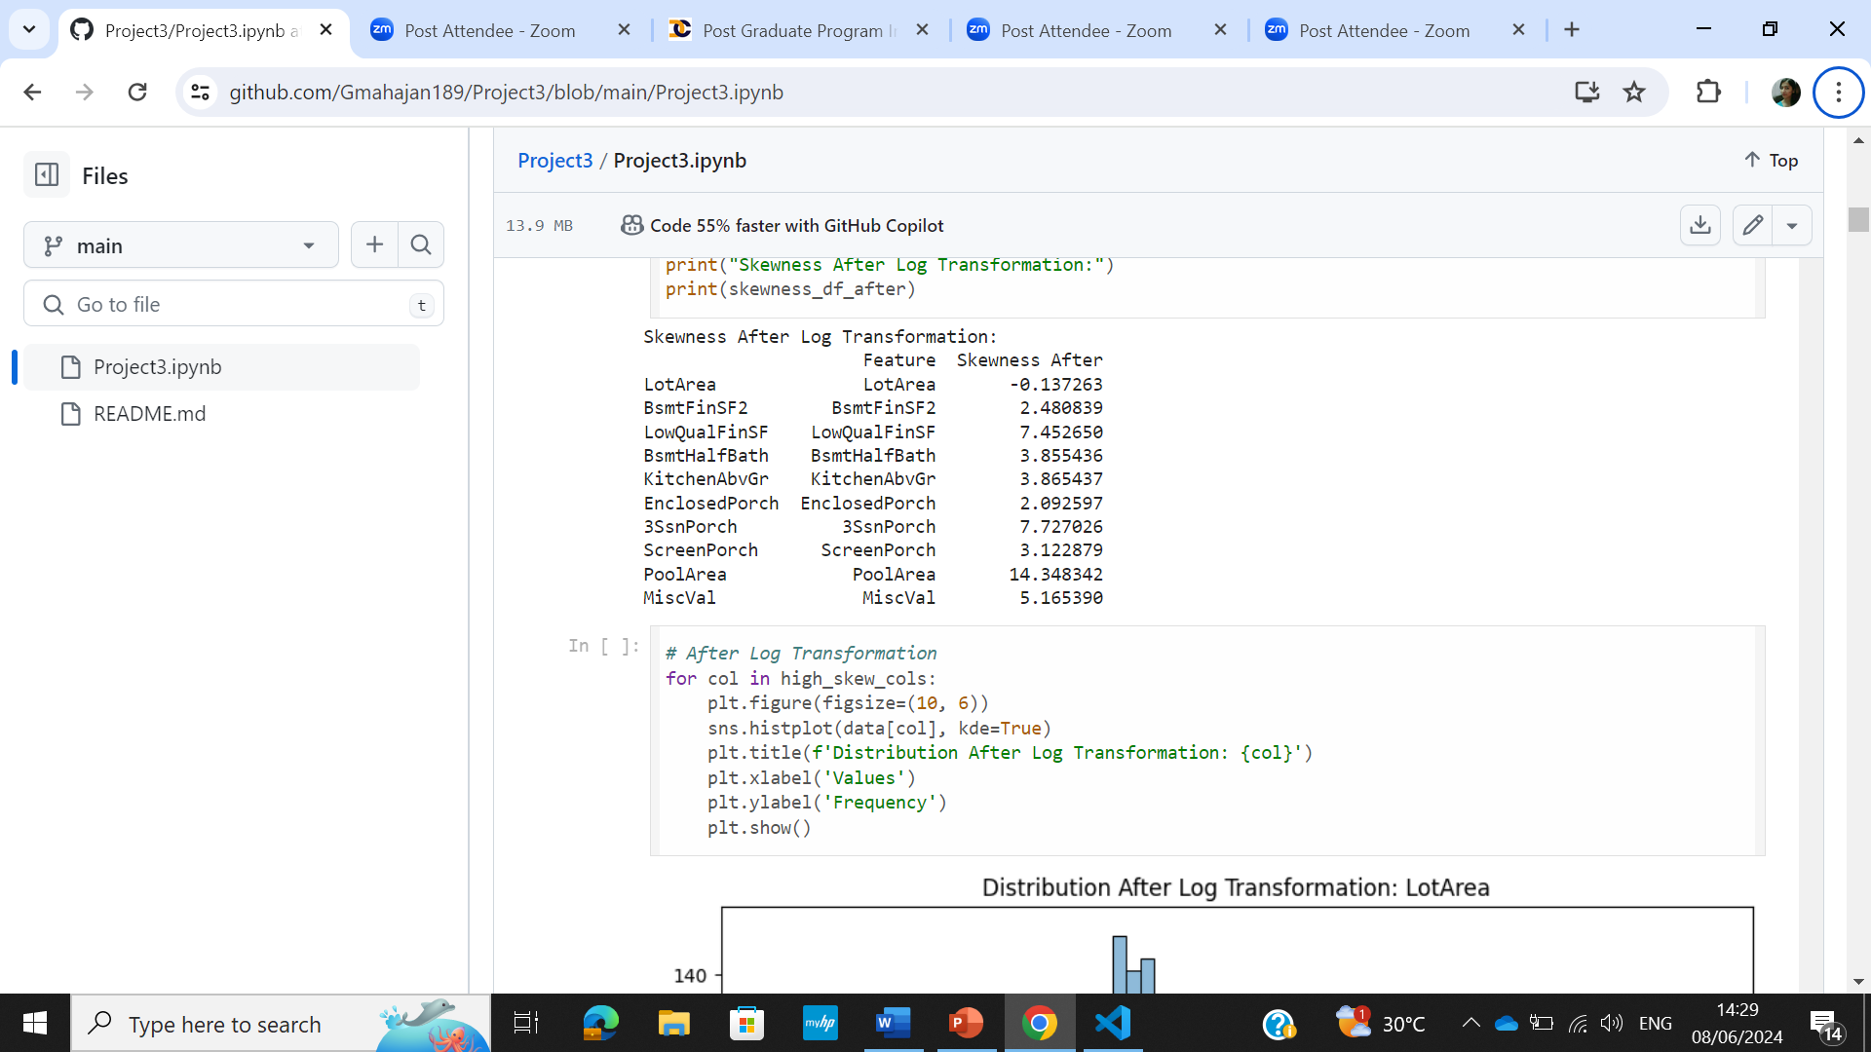
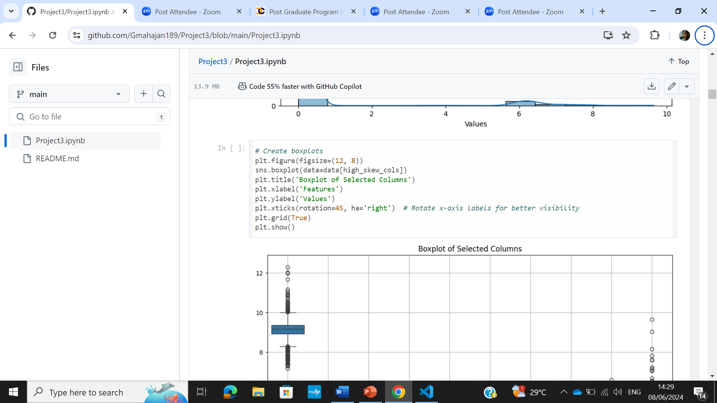
Solution
After logarithmic transformation skewness was checked and distribution was plotted
To construct the box-plot for the selected columns

Slide 11
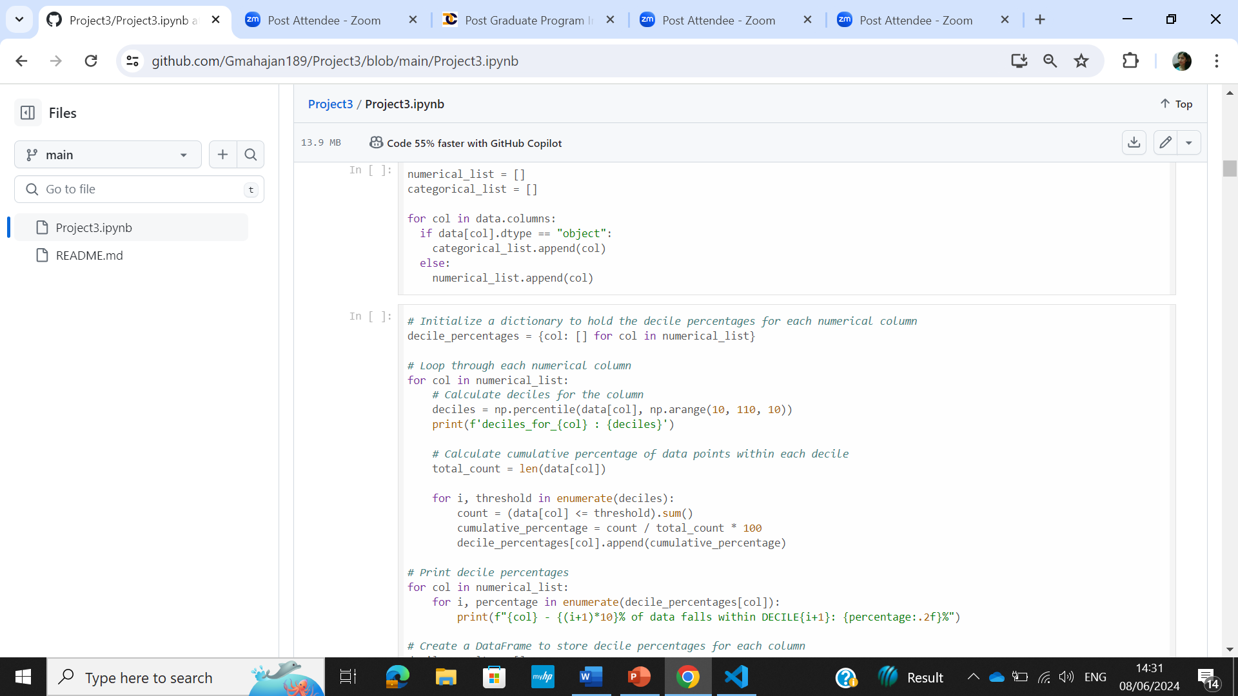
Solution
Numerical and Categorical list was made
The decile percentages for each column were calculalated to know how the data is distributed within every decile

Slide 12
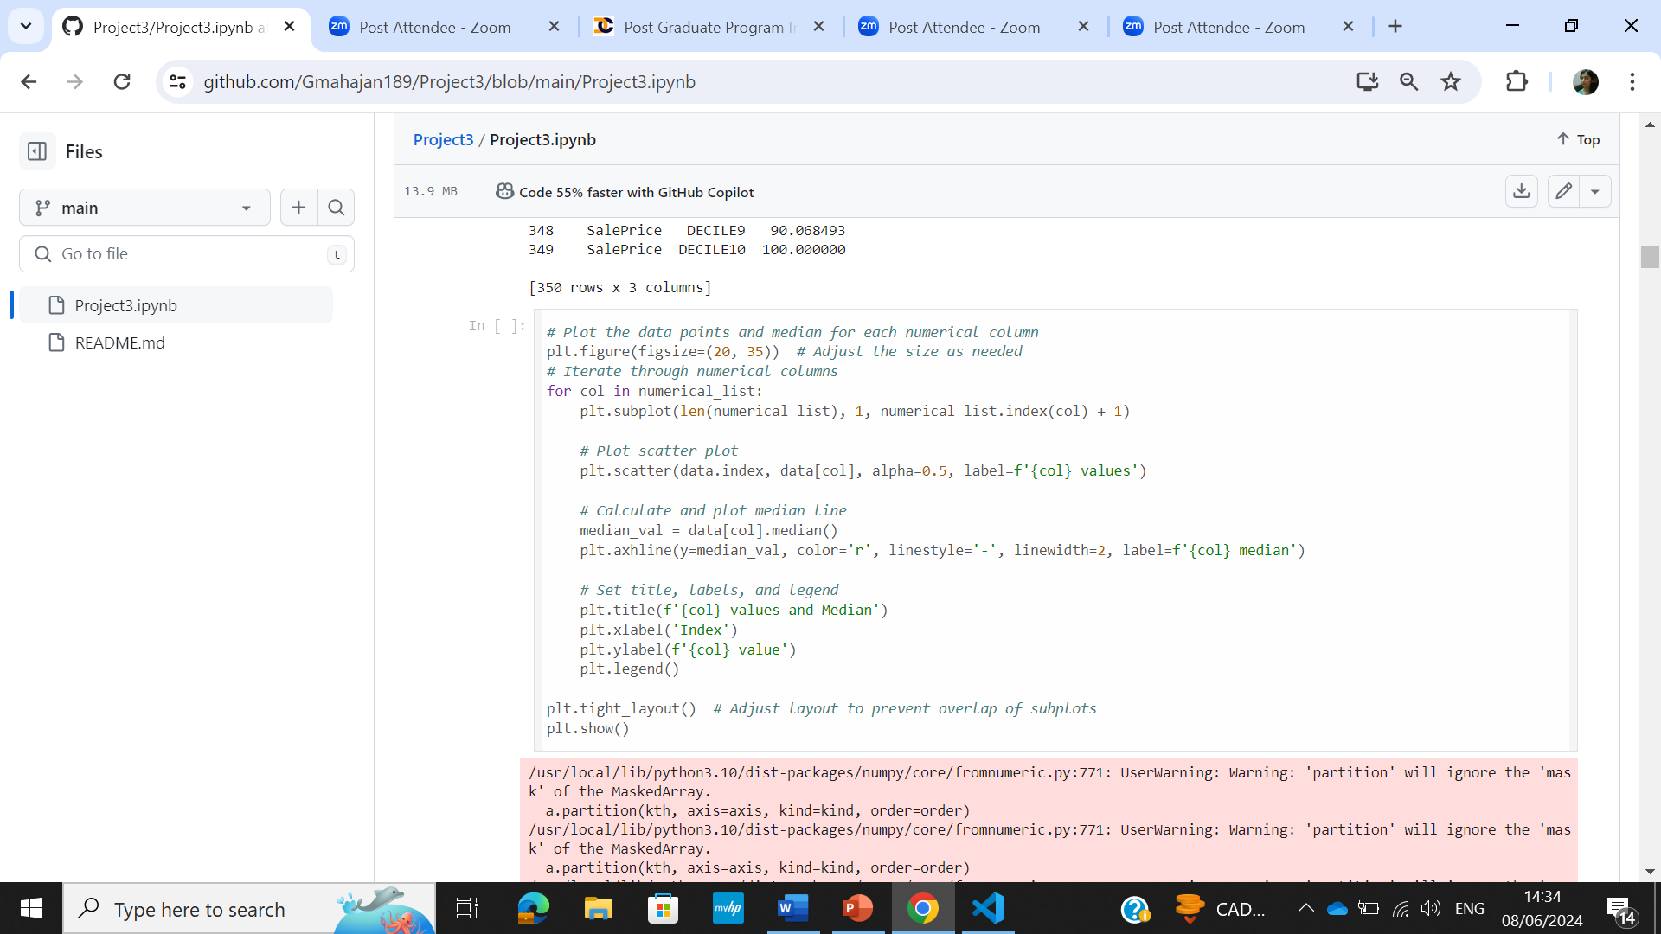
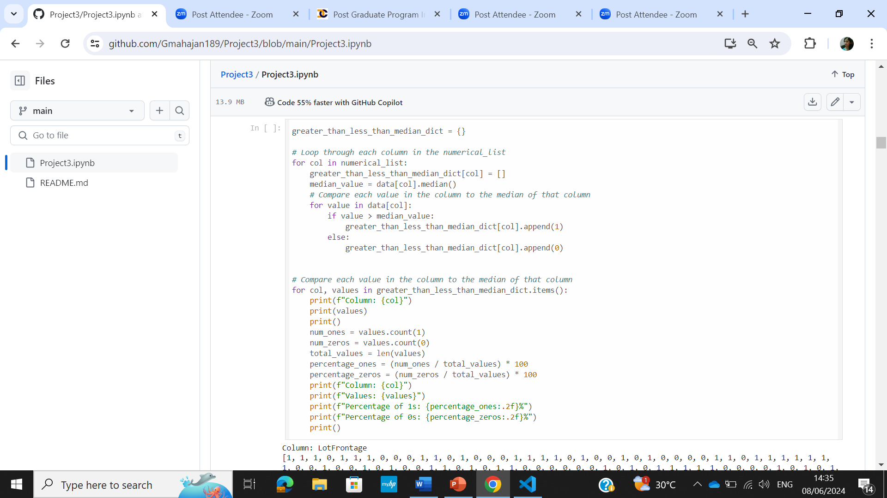
Solution
Data distribution for each column along the median was plotted using scatter plot
Dictionary was made and the percentage data greater than,less than median was stored

Slide 13
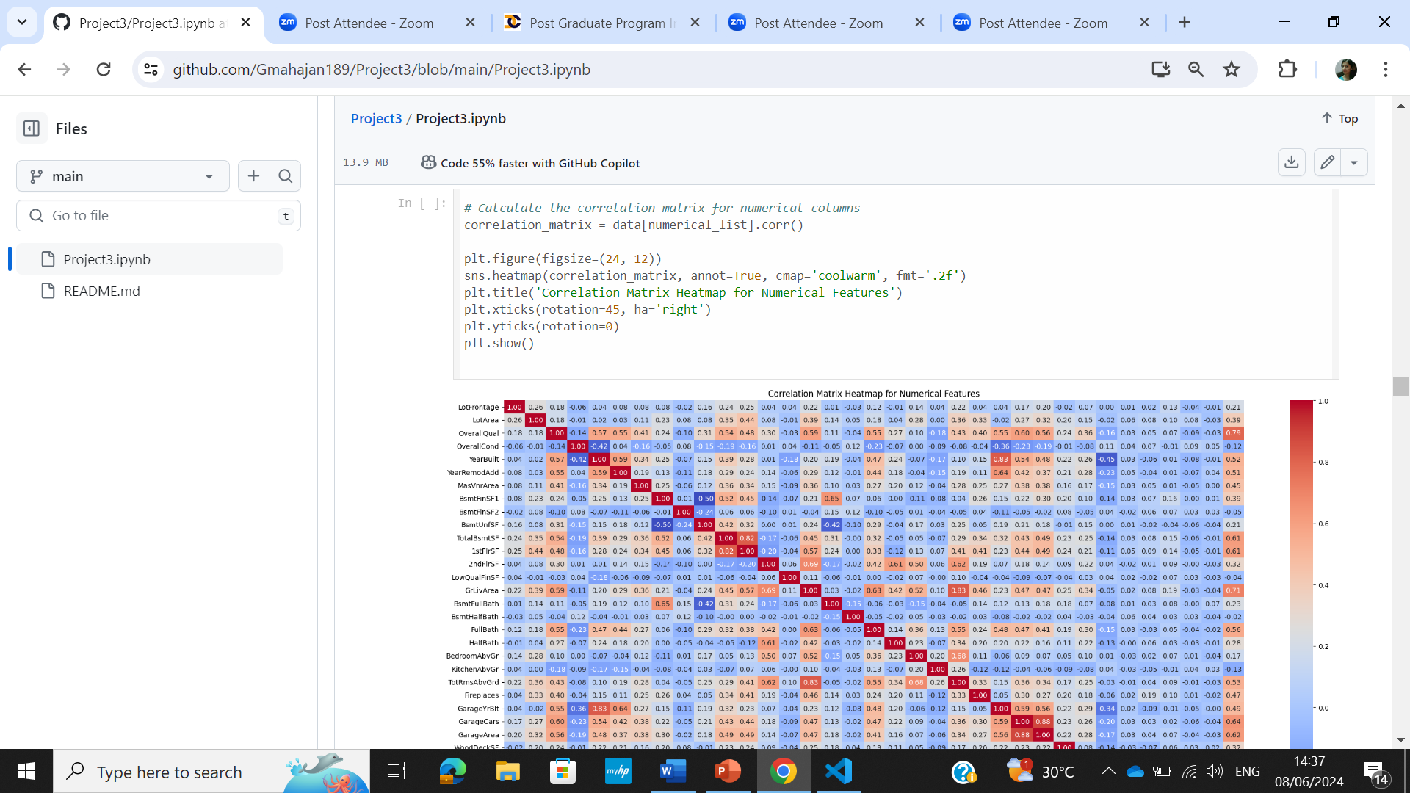
Solution
To calculate the correlation matrix for the selected columns and create heatmap to visualize the correlation

Slide 14
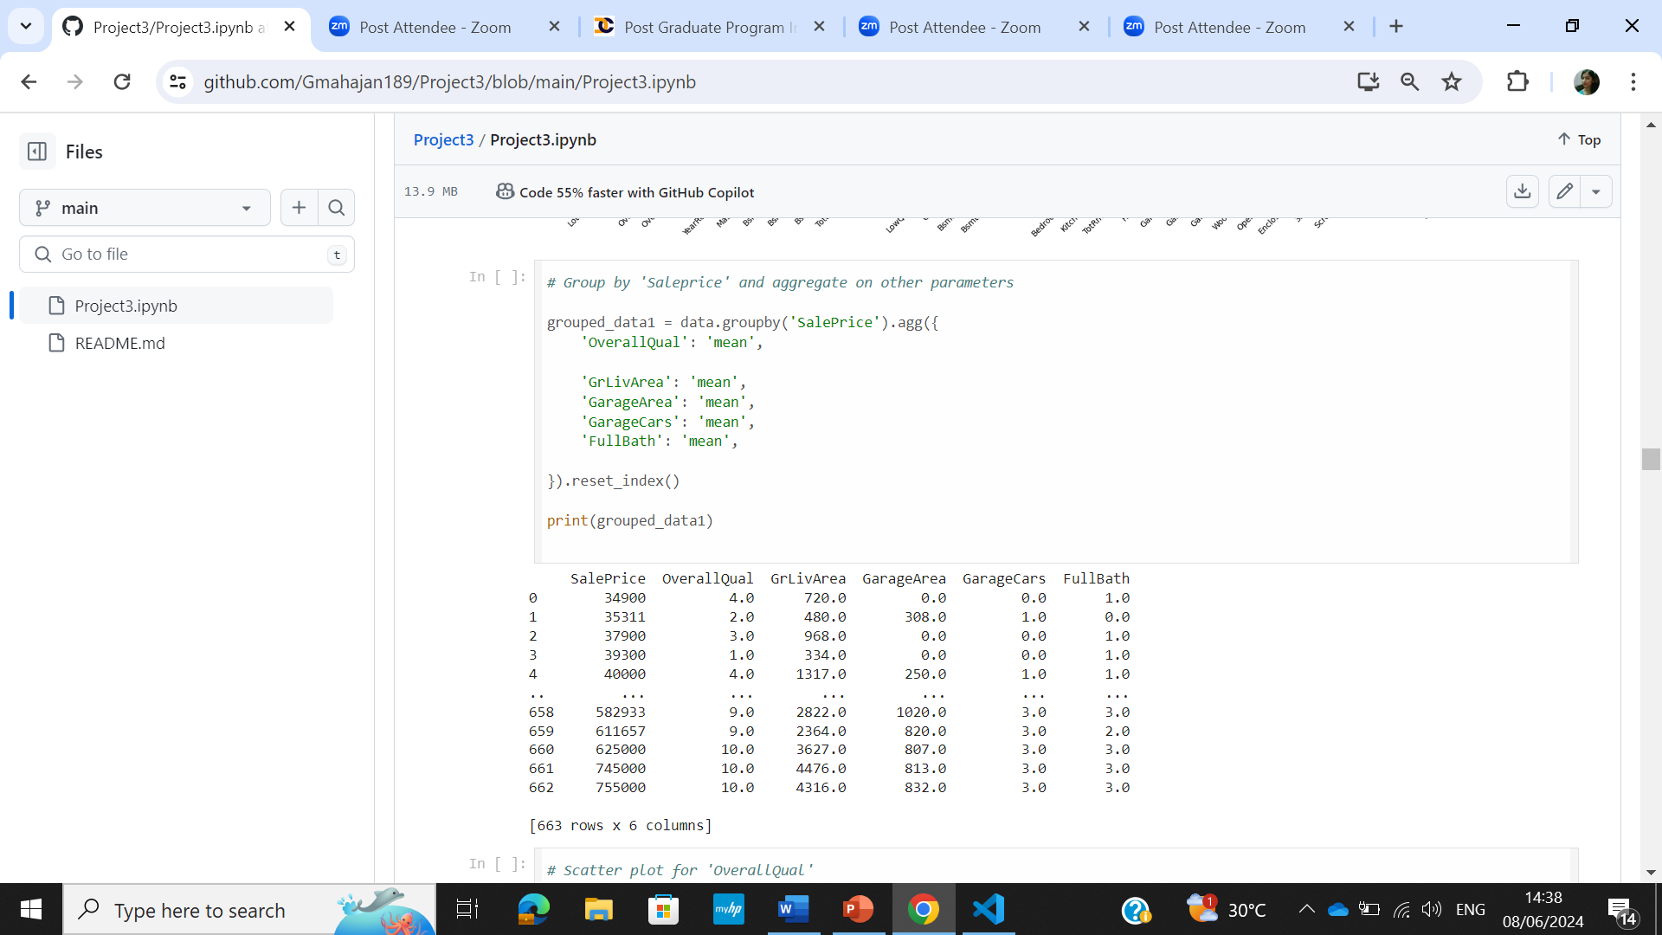
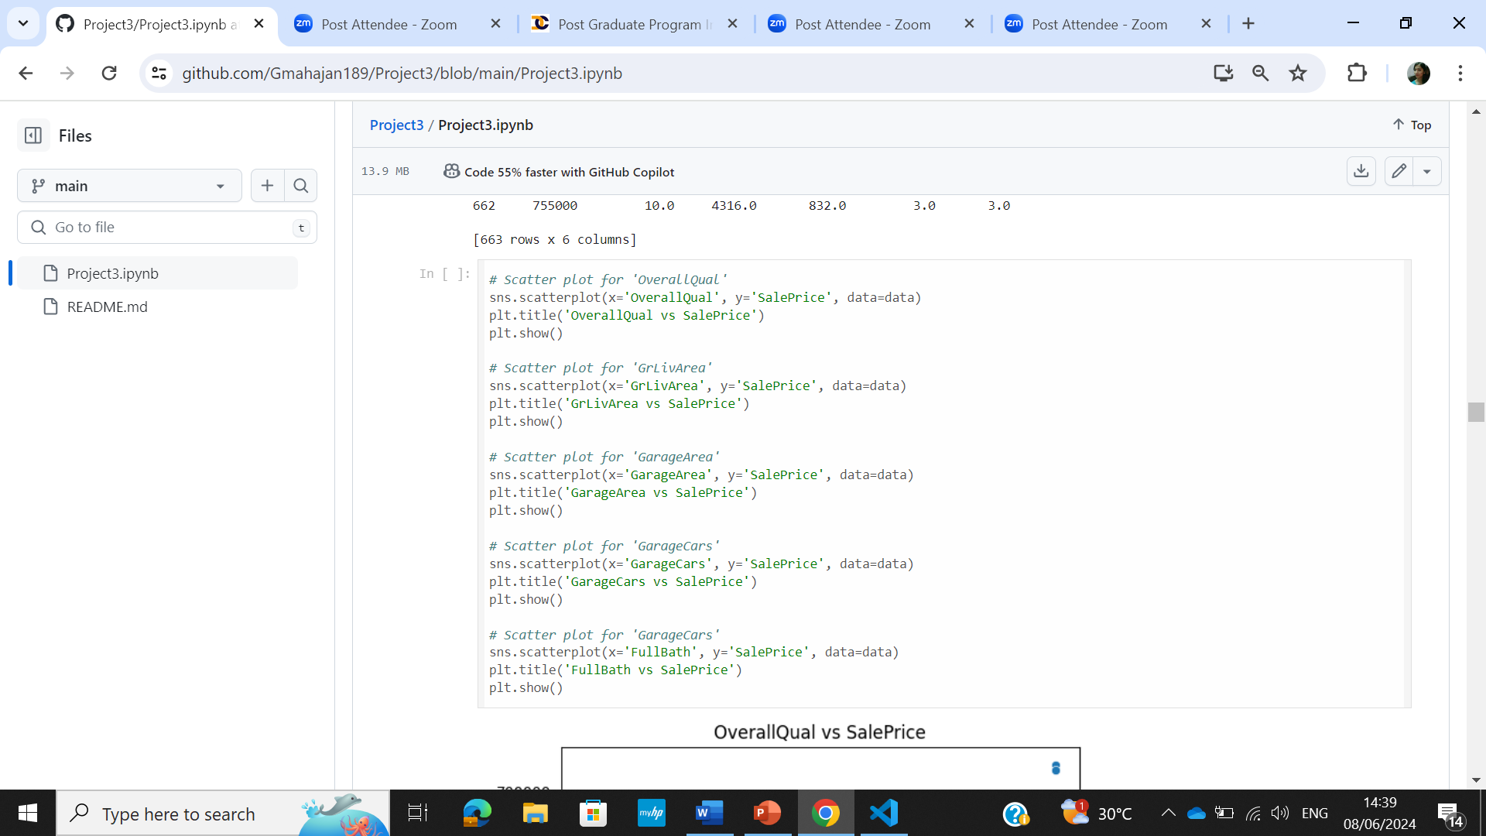
Solution
Data was grouped using Groupby on ‘Saleprice’
Scatterplots were made for the selected column

Slide 15
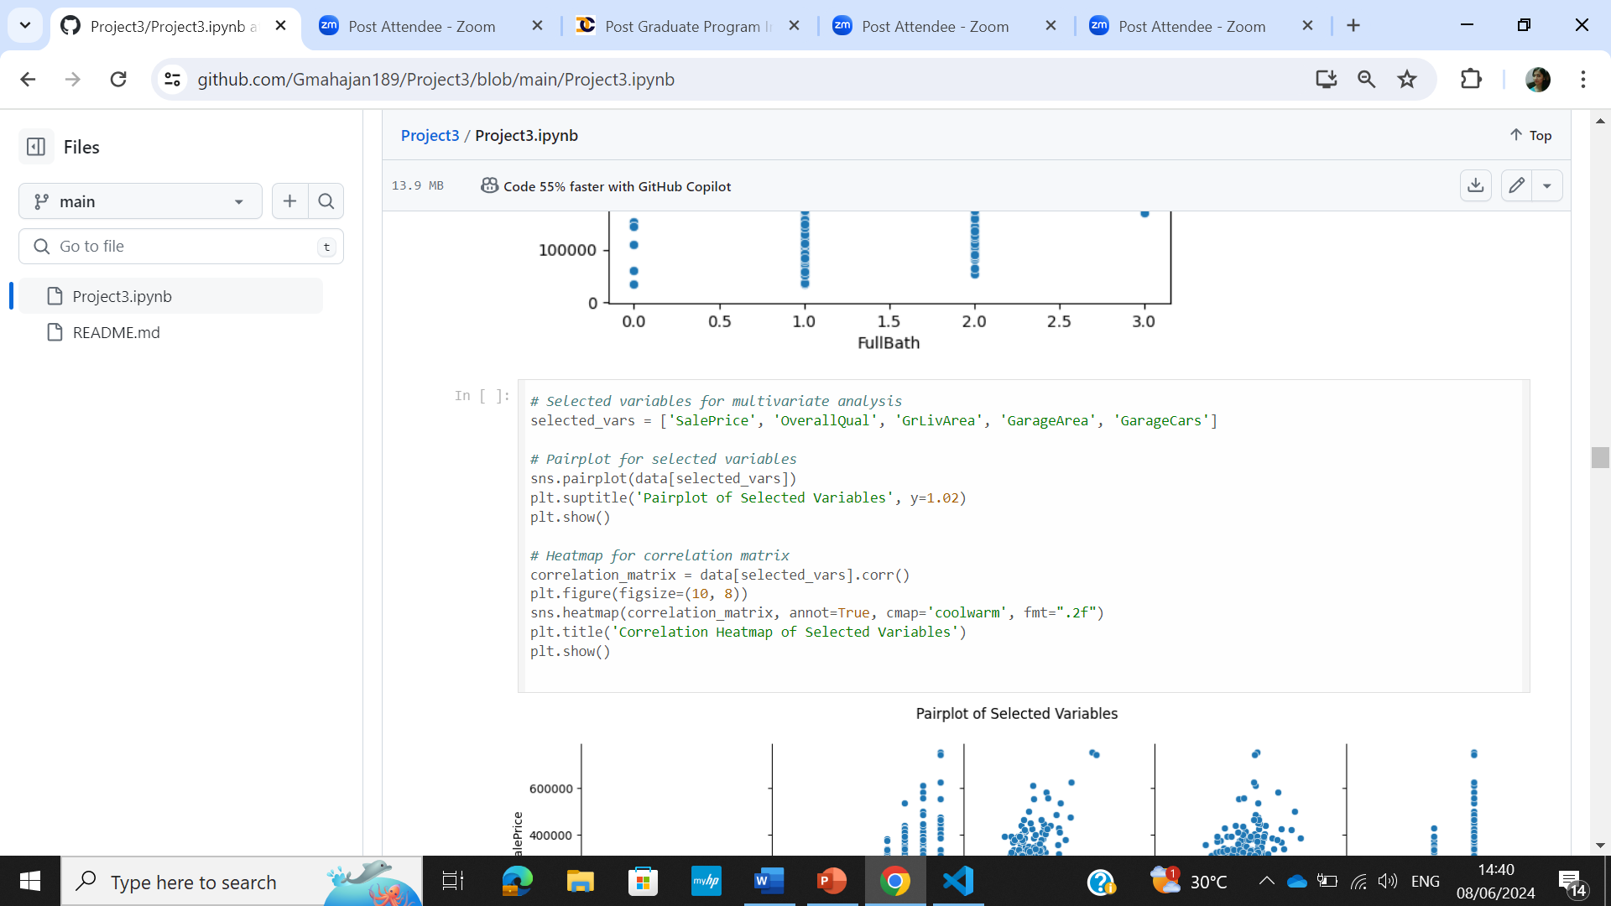
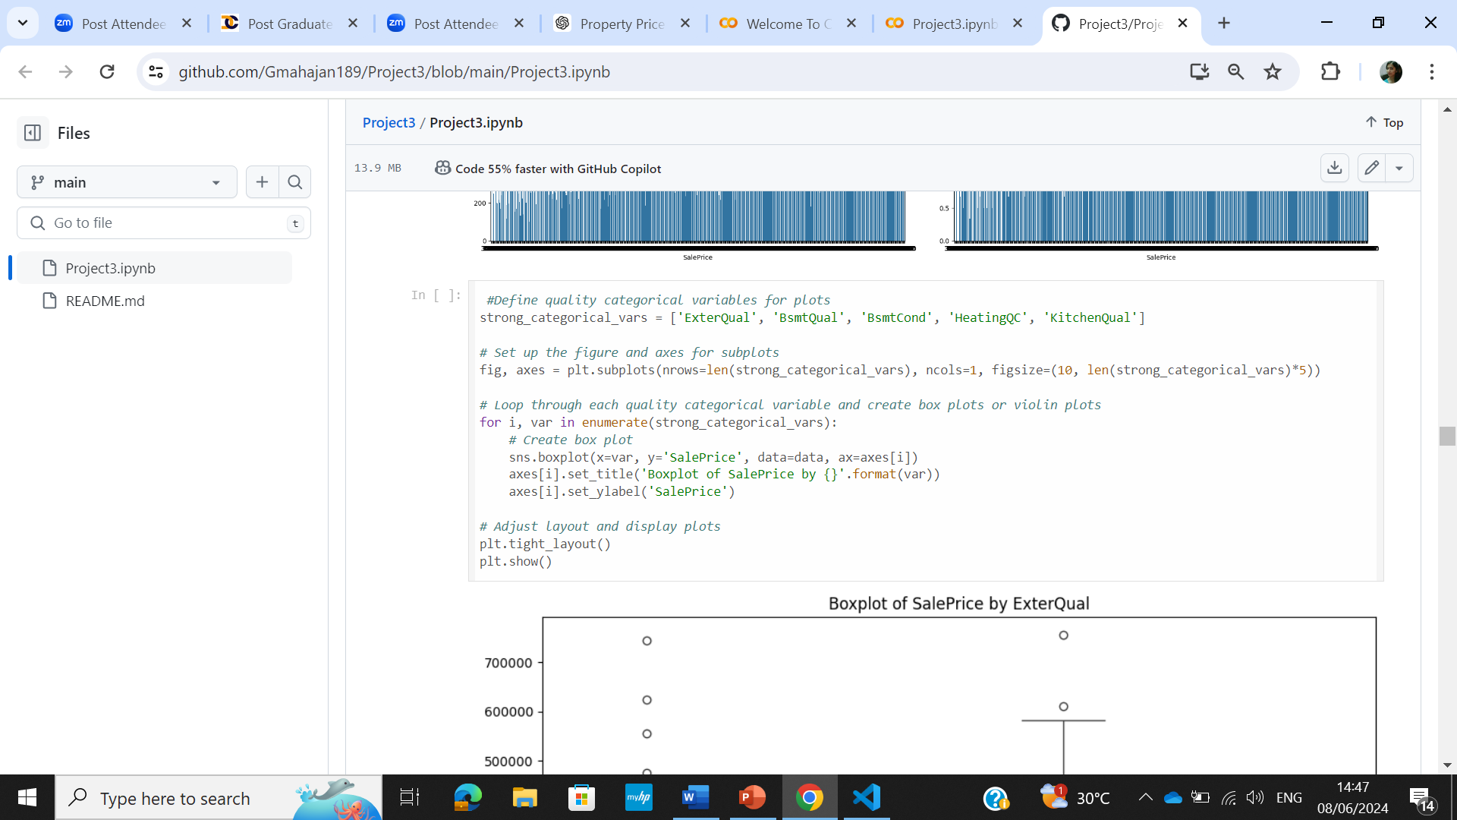
Solution
Pairplots were made for the selected column
Boxplots were made for the selected variables with saleprice

Slide 16
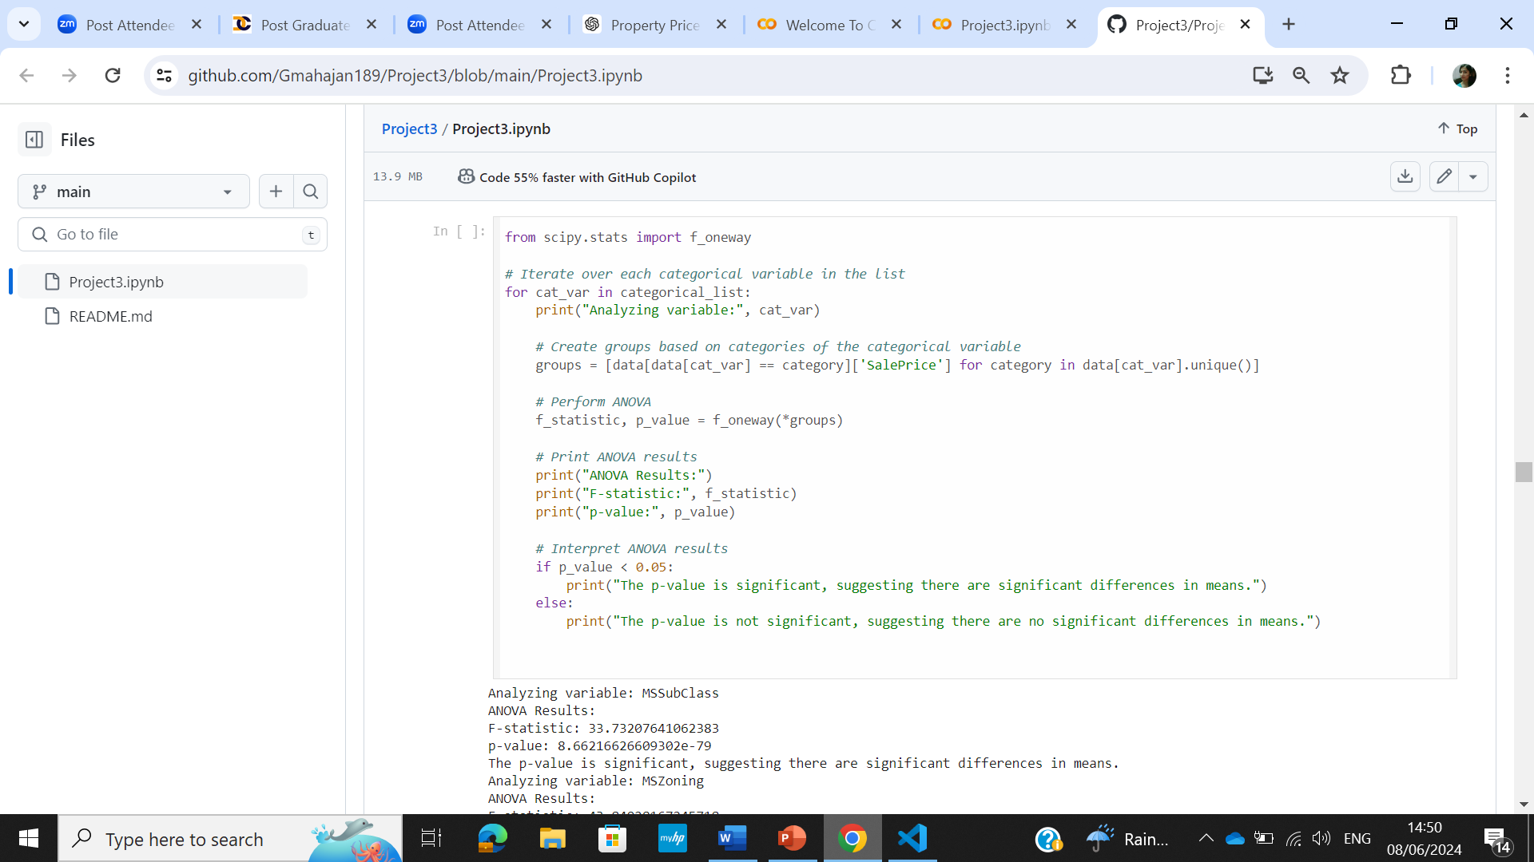
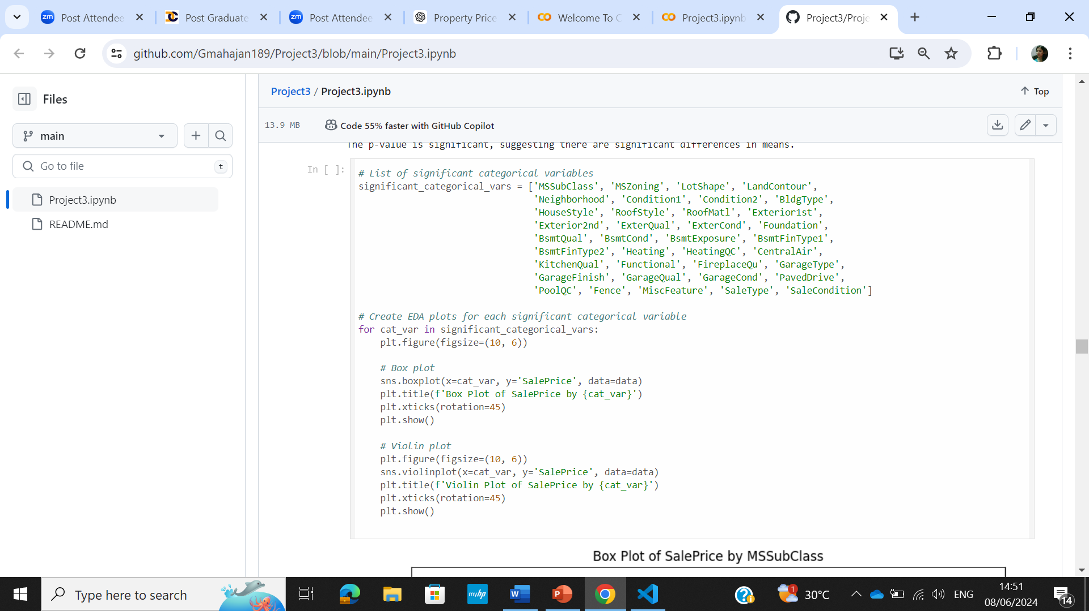
Solution
ANOVA was used to analyse relationship between categorical cols and saleprice
EDA plots were made for the significant categorical variables

Slide 17
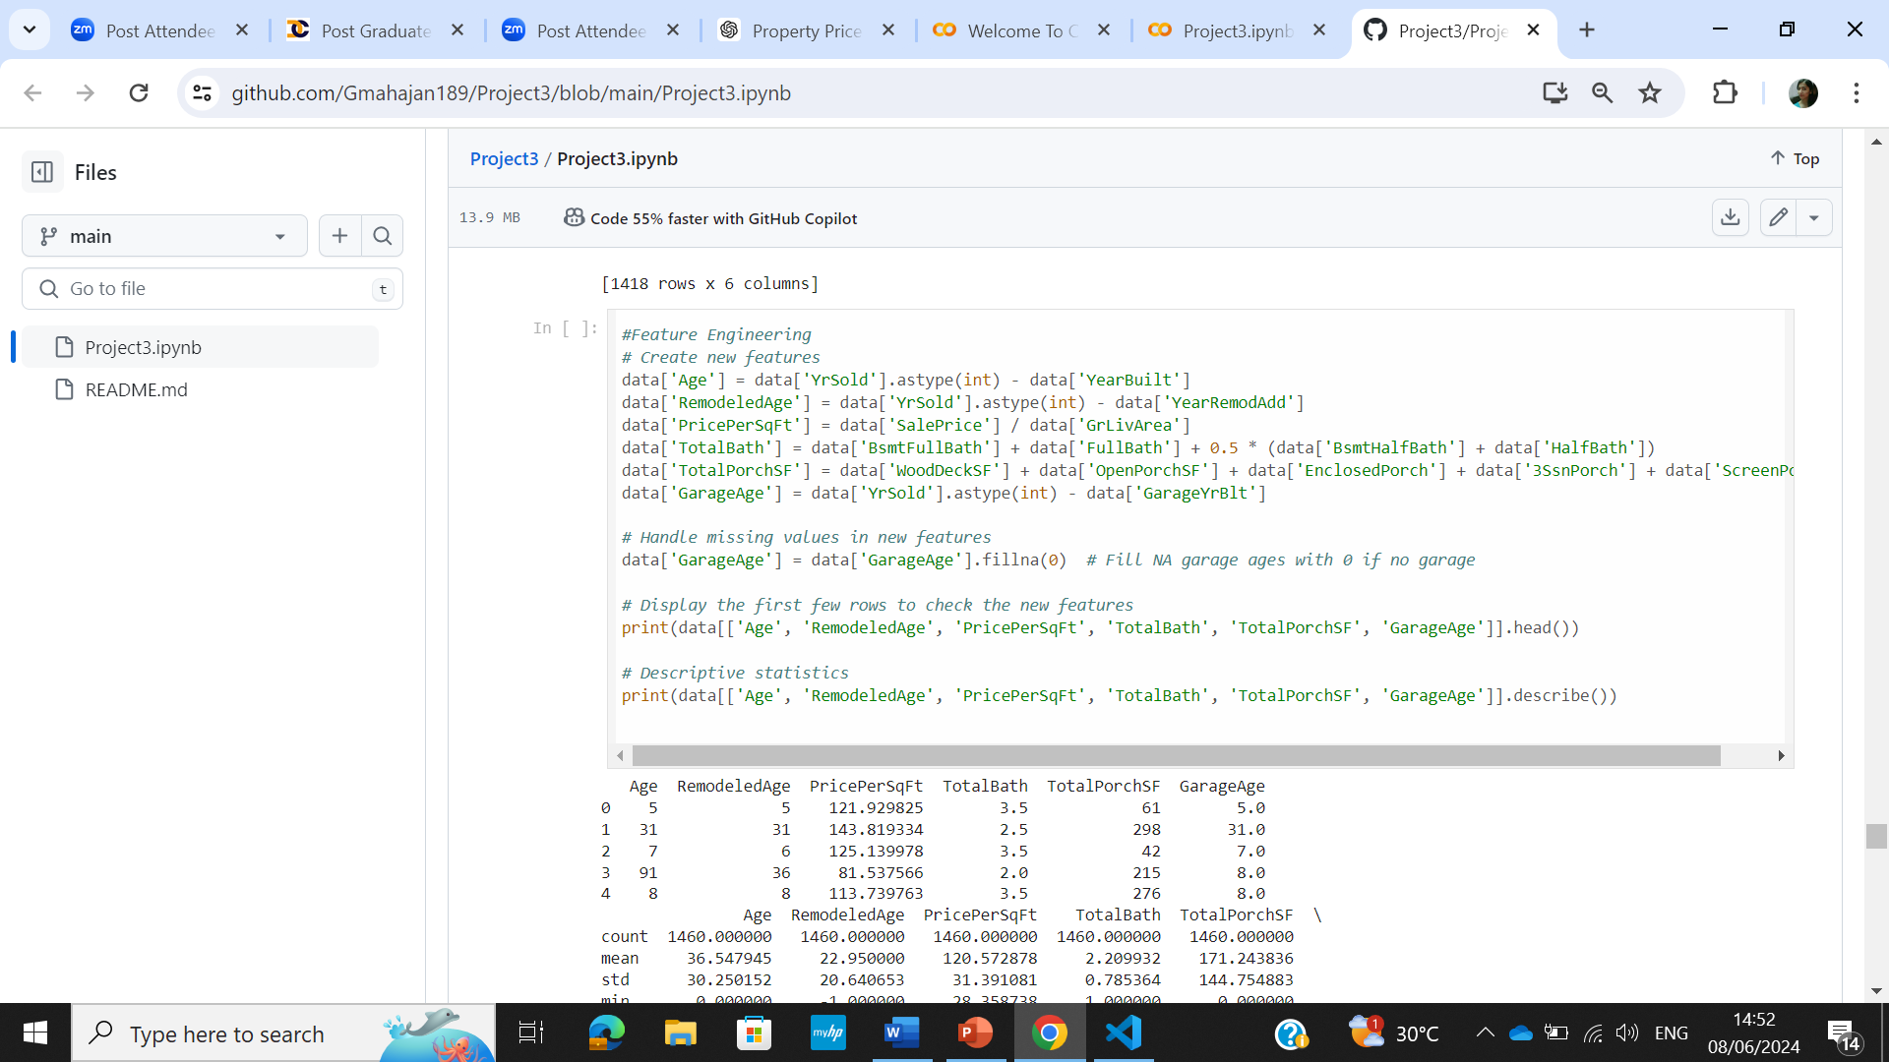
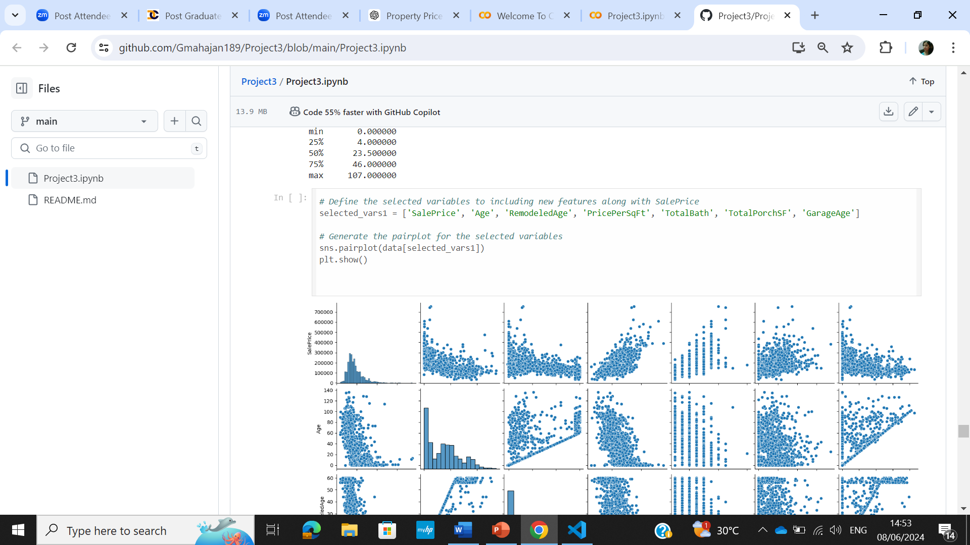
Solution
Feature Engineering new features were generated
Plotting new features

Slide 18
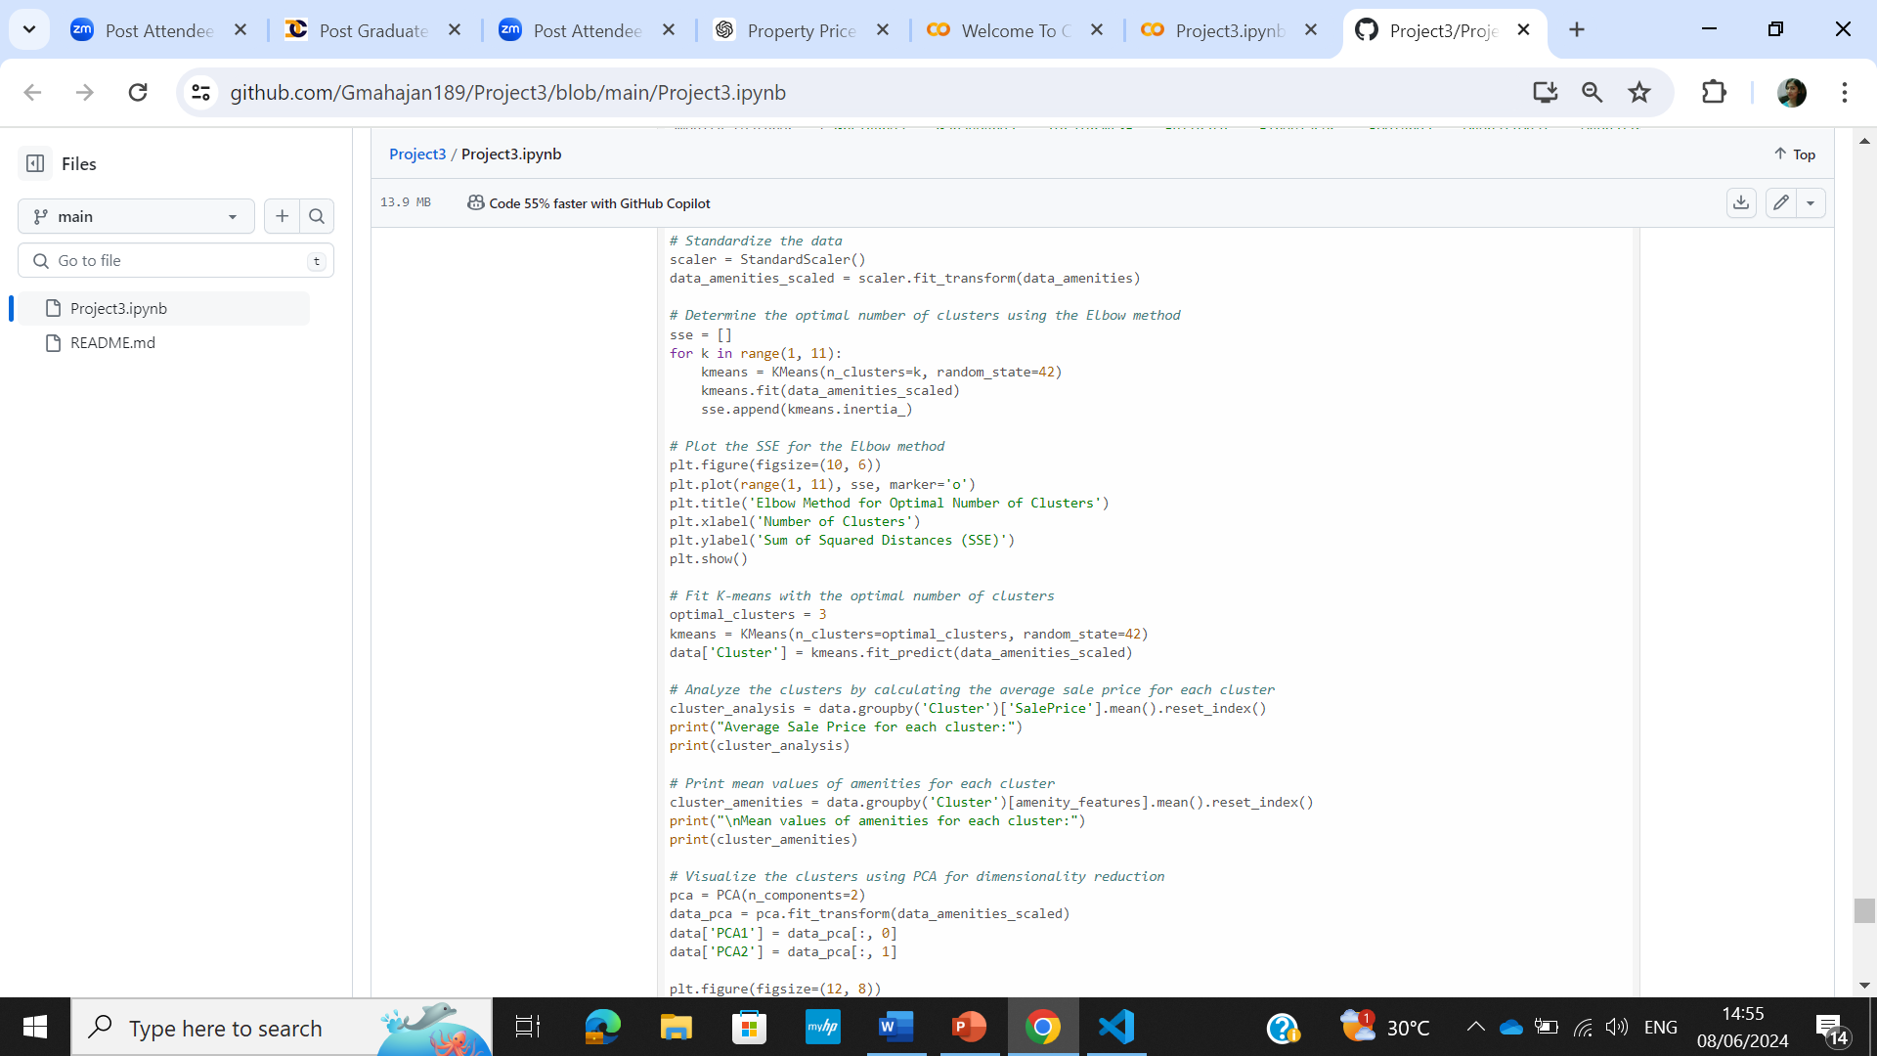
Solution
Clustering was done to help identify patterns and segment properties into different groups that share similar characteristics

Slide 19
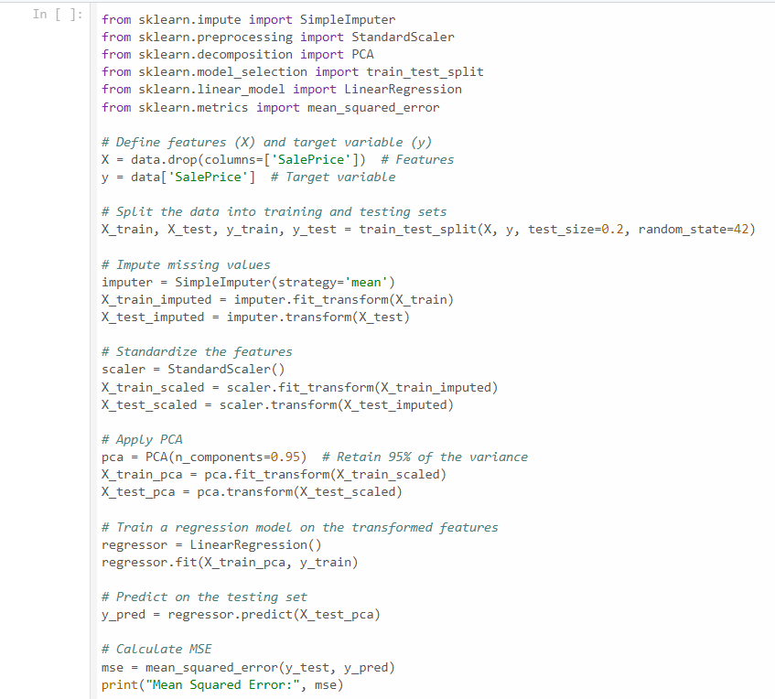
Solution
ML Modelling was done and target variable was defined, data was split into training and test sets and algorithm was chosen based on the dataset

Slide 20
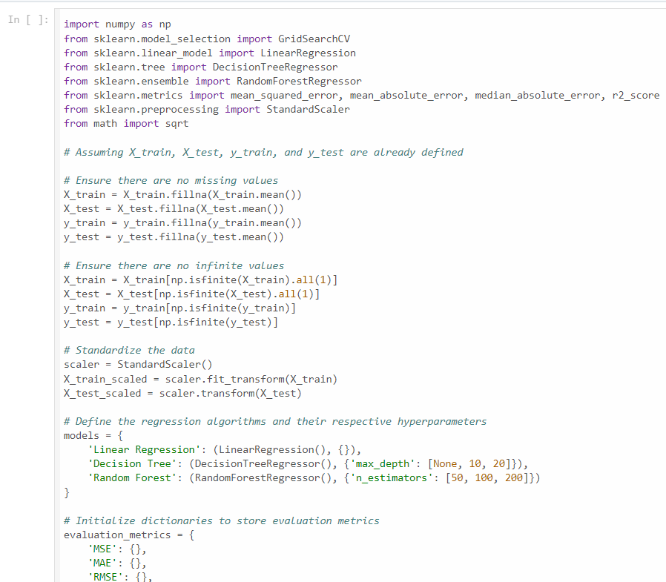
Solution
Different models were employed and their performance metrics compared to check the best model

Slide 21
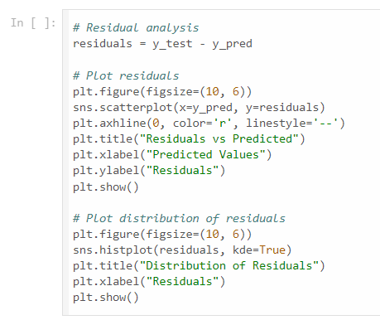
Solution
The residuals (error) was plotted to see the distribution if it it is centered around 0 or not

Slide 22
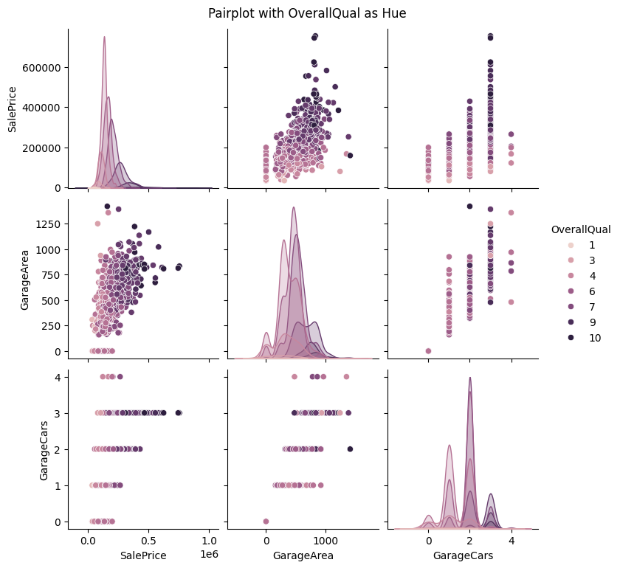
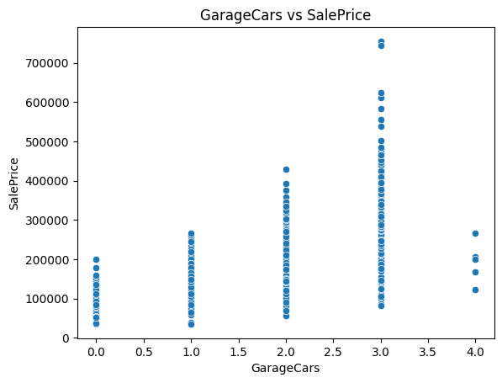
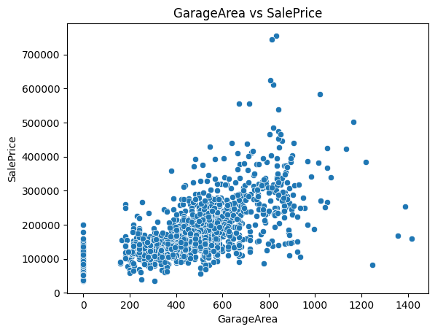
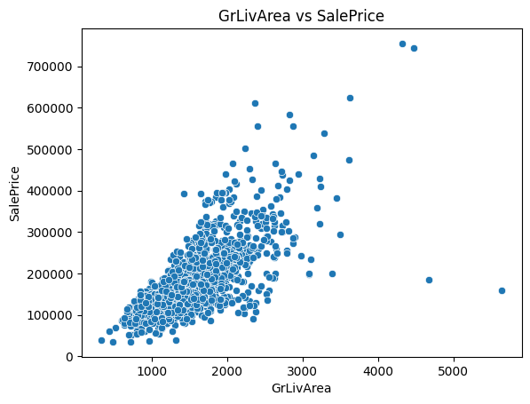
EDA Plots and Conclusion
These scatter plots collectively illustrate that key features like overall quality, garage area, and living area are significant factors influencing property prices.
Properties with better quality ratings and larger garage and living areas tend to command higher prices in the market.

Slide 23
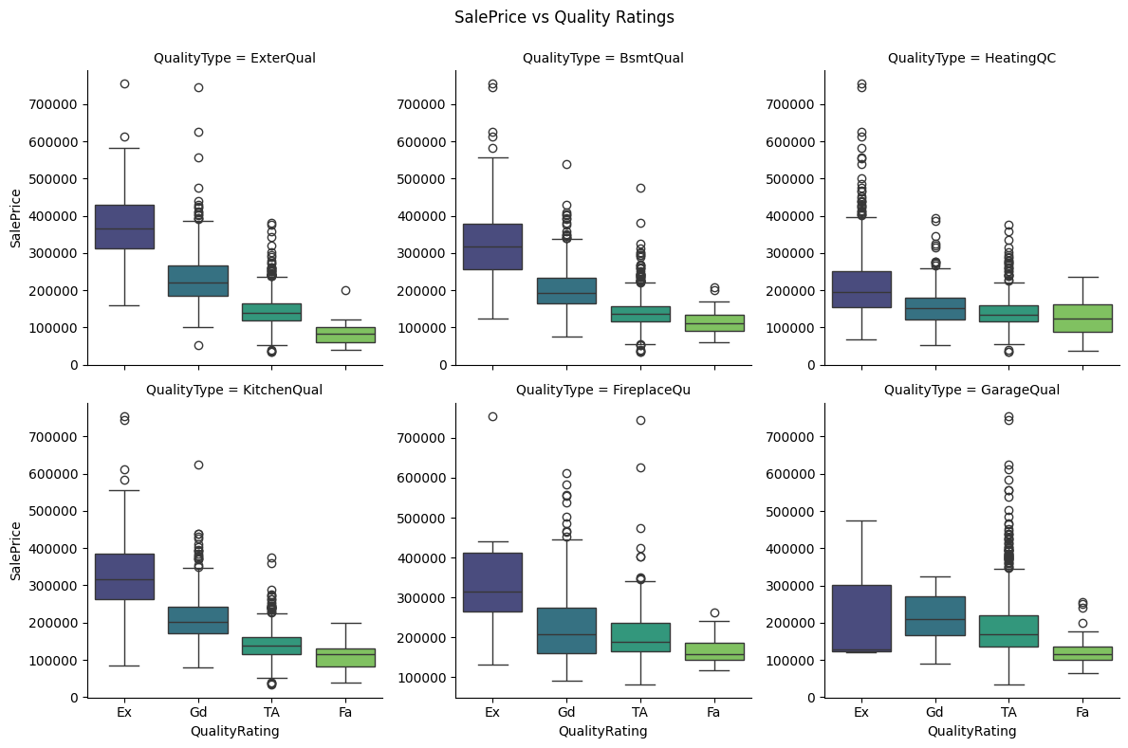
EDA Plots and Conclusion
It is evident that the quality rating of "Excellent" has the highest average sale price, followed by "Good". The other quality ratings fall within a lower range of sale prices.
This suggests a clear positive correlation between the quality rating of a property and its sale price, with higher quality ratings corresponding to higher sale prices.

Slide 24
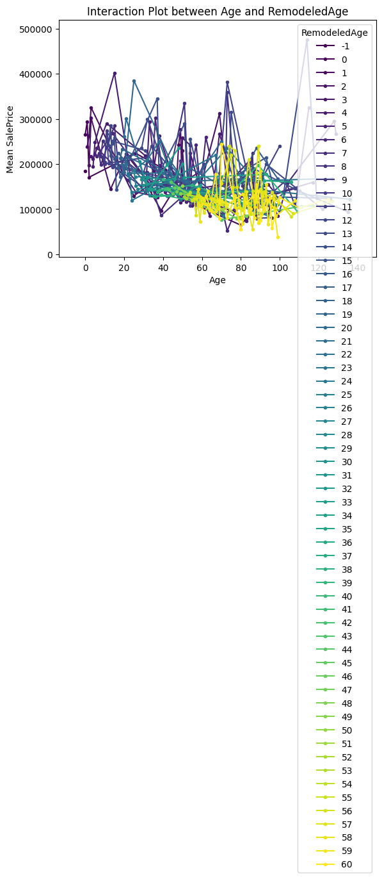
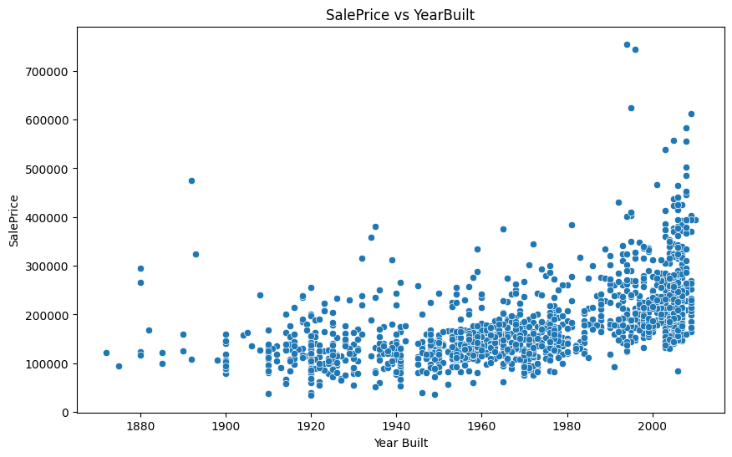
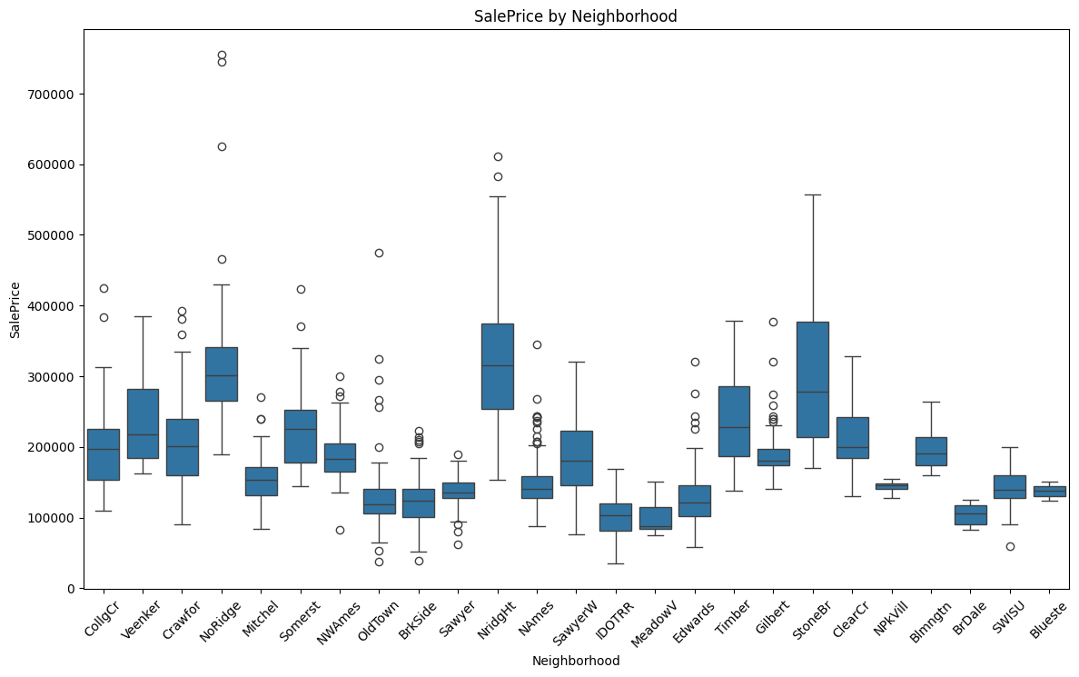
EDA Plots and Conclusion
There is a negative relationship between the age of the property and its sale price. As the age of the property increases, the sale price tends to decrease. This suggests that newer properties are valued higher in the market compared to older properties.
Sale prices vary significantly by neighborhood. Some neighborhoods have higher average sale prices compared to others, indicating that location is a crucial factor in determining property prices. Certain neighborhoods might be more desirable due to factors like amenities, safety, school districts, and overall prestige.

Slide 25
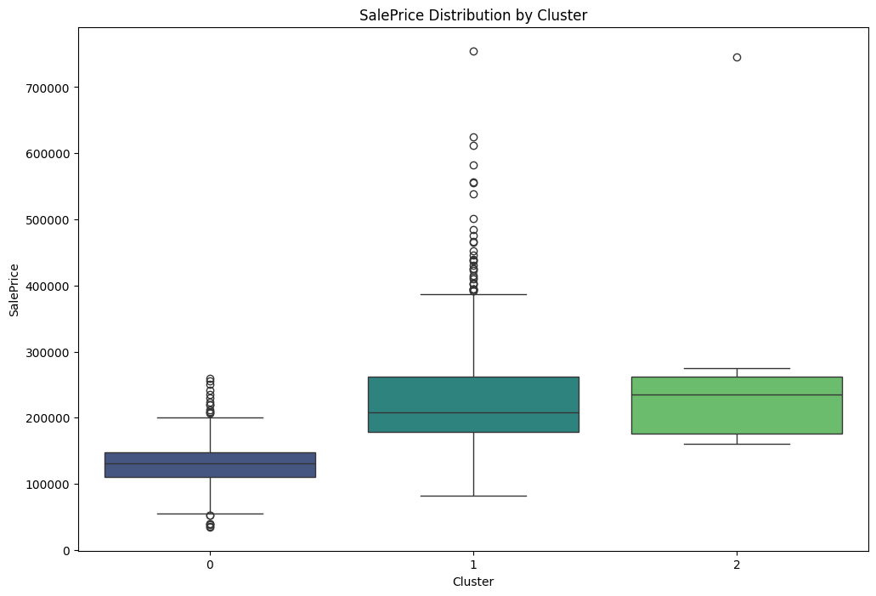
EDA Plots and Conclusion
Cluster 0: This cluster represents modestly-sized properties with fewer amenities, likely appealing to budget-conscious buyers seeking affordable options with basic features.
Cluster 1: Properties in this cluster offer mid-range amenities and quality, suitable for average buyers looking for moderately-sized homes with standard features.
Cluster 2: This cluster comprises upscale properties with luxurious amenities, including spacious living areas, large garages, and additional features like fireplaces and pool areas, appealing to high-end buyers seeking premium homes.

Slide 26
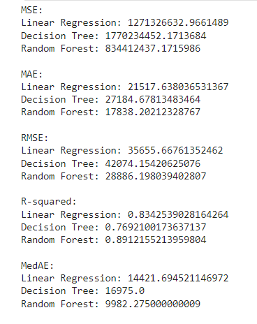
Modelling results
Based on the performance metrics , it's evident that the Random Forest model outperforms both the Linear Regression and Decision Tree models across multiple metrics, including lower Mean Squared Error (MSE), Mean Absolute Error (MAE), Root Mean Squared Error (RMSE), and higher R-squared value.
This suggests that the Random Forest model provides a better fit and higher accuracy in predicting the target variable compared to the other two models. Therefore, it can be concluded that the Random Forest model is the most effective among the three for this particular task.
MSE: Mean Squared Error
MAE: Mean Absolute Error
RMSE: Root Mean Squared Error
MedAE: Median Absolute Error

Slide 27
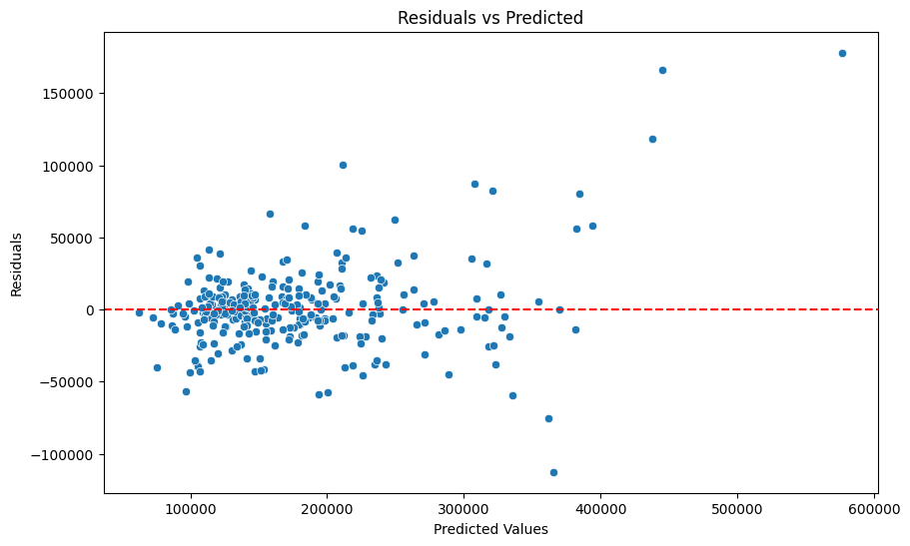
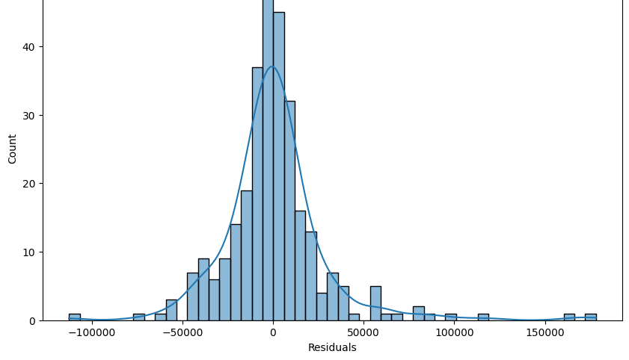
Modelling Results
Uniform distribution of residuals around zero indicates balanced errors across predicted values, ensuring the model isn't consistently over- or under-predicting.
Even spread of residuals reflects a well-fitted model, capturing data patterns effectively and providing reliable predictions.

Slide 28
THANK YOU!

